Slide 1
Week 2

Slide 2
GIT IN TERMINAL

Slide 3
PROGRAMMING BASICS REVIEW

Slide 4
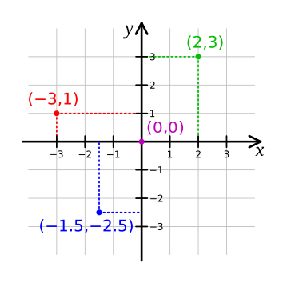
Coordinates
Notes:
Cartesian coordinate systems

Slide 5
TA – Ask This GUY Questions
Luobin Wang
wangl073@newschool.edu

Slide 6
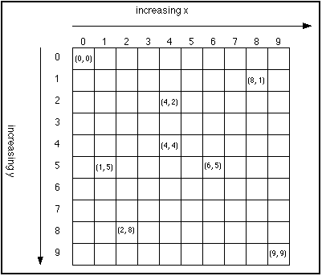

Slide 7
Syntax
parameters
semicolon
ofBackground(100, 200, 300);
function name
parentheses
Notes:
parameters are sometimes also referred to as arguments or options
even if there are no parameters, you will need an empty set of parentheses
DON'T FORGET YOUR SEMICOLONS

Slide 8
Variables
void setup() {
our code goes here;
//we comment here
}
void draw() {
our code goes here;
//we comment here
}
ONCE
ONCE
LOOP
Notes:
Now let’s build a sketch
SETUP sets up your environment… it defines elements that run once
DRAW runs through the code and repeats once it reaches the end
{ Opens a code block
} Closes a code block
; goes at the end of code statements
// Comments

Slide 9
Variables
Think of variables as containers for holding pieces of information.
You need different containers for different types of information.

Slide 10
Variables
Two really useful features:
1. Data can be stored in a computer's memory so a program can access it and use it over and over.
2. Even better, a program can change this information while running.

Slide 11
Variables
What sort of things can you do?
Keep track of information related to shapes: color, size, location.

Slide 12
Data types
int
whole numbers
1, 2, -3, 40, 2013
float
floating point number (decimal points)
0.5, 1.34, 11.5, 7.0/2.0

Slide 13
Data types
String
ASCII characters, declared in quotation marks
"lemon", "meringue", "pie"
boolean
true, false
color
colors; by default uses RGB
(255, 177, 80)

Slide 14
Variables are declared and initialized(assigned).

Slide 15
Structure
Declarations
int x; //declare a variable for x
float y; //declare a variable for y
Notes:
"The first part of the code is going to contain variable declarations which you've already learned. As we go on, other things will appear here in the beginning such as the creation of objects and other pieces of code.
It is important to note that variables declared here are considered "global" variables, meaning they will be accessible to all of the code in the entire sketch. We will show examples of "local" variables later and how you might run into problems, but you should be putting all of your important variables here at the beginning"

Slide 16
Structure
Declarations
Setup
int x; //declare a variable for x
float y; //declare a variable for y
void setup() {
size(500,500);
x = 0; //initialize x to 0
y = 5.3; //initialize y to 5.3
}
Notes:
"This part should look a little new. The first real part of the dynamic code structure is the setup. Everything between the two curly brackets will run only once at the very beginning of the sketch. This is where you will want to put things that set up your sketch such as size of the applet window, background color, loading images into the sketch (so that you aren’t loading images over and over, slowing down your program), etc.
MAKE REFERENCE TO THESE PIECES BEING MODULES/CHUNKS OF CODE
It is also good practice to "initialize" your variables here. This is actually loading values into your variables so that your sketch runs the way it needs to. Some variables might need to be initialized while others might not. It can be done in the initial declarations (for ex. "int x = 3;") but it is good practice to put them in the setup.
Note the syntax used: open and closed parentheses in addition to the curly brackets. If you have a foreign keyboard make sure you know how to use these.

Slide 17
Structure
Declarations
Setup
Draw
int x; //declare a variable for x
float y; //declare a variable for y
void setup() {
size(500,500);
x = 0; //initialize x to 0
y = 5.3; //initialize y to 5.3
}
void draw() {
ellipse(50, 200, x, x); //draw a circle
rect(100, 100, 30, 50); //draw a rectangle
}
Notes:
The Draw loop is where the meat of your sketch will go. Things between these curly brackets will run one line at a time from start to finish then loop back again to the beginning, running over and over again until the sketch is stopped.

Slide 18
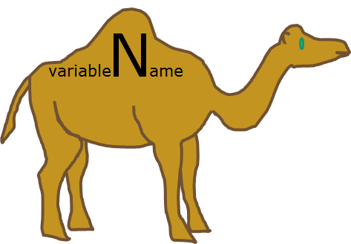
Naming Conventions
just use camelCase, actually. (but there are others)

Slide 19
Commenting Review
int variable2; //We can leave comments for ourselves
float readingValue; //Anything after the double slash is ignored
//by the compile
/*
This type of comment also works. Everything between these two symbol pairs is ignored
*/
Notes:
use to -
- give yourself (and other people notes)
- “turn off” blocks of code during development / testing
i ALWAYS forget what stuff i made in old code means and it takes ages to figure it out again if i don’t leave detailed comments

Slide 20
ALL VARIABLES MUST HAVE...
A TYPE
why? - so the computer knows exactly how much memory should be allocated to store that variable’s data.
A NAME
why? - so the computer (and you) can make sense of everything.

Slide 21
VARIABLE NAMING TIPS:
- Avoid using words that appear elsewhere in Processing. (e.g. - don’t name a variable mouseX)
- Use names that mean something connected to what the variable is to be used for. (duh)
- Don’t start with capital letters! Use camelCase. (there’s a good reason for this but we’ll get there later)

Slide 22
There are also in-built System Variables for us to make use of
ofGetWidth
ofGetHeight
mouseX
mouseY
ofFrameCount
Notes:
first use special variables to set some basics.
make a shape follow the mouse.

Slide 23
Operators for simple math
An operator is a symbol that represents an operation.
The basics:
+ - * / =
This may be new to you:
%
Notes:
use operators to increment variables in the draw loop.
make some crazy procedural animations with shapes.
shape that changes over time, makes a drawing (see old jul19 sketches)

Slide 24
int a = 5 % 4; // Sets 'a' to 1 int b = 125 % 100; // Sets 'b' to 25 float c = 285.5 % 140.0; // Sets 'c' to 5.5 float d = 30.0 % 33.0; // Sets 'd' to 30.0

Slide 25
What happens if you try to add a float and an int together?

Slide 26
Debugging
cout << “Hello World!” << endl
Notes:
track one of the incrementing variables, maybe to see one that has moved offscreen?
increment a variable in setup to see why it isn’t working?
then move it into the draw loop.
also use a string to write out some labeled data.

Slide 27
OF SYNTAX

Slide 28
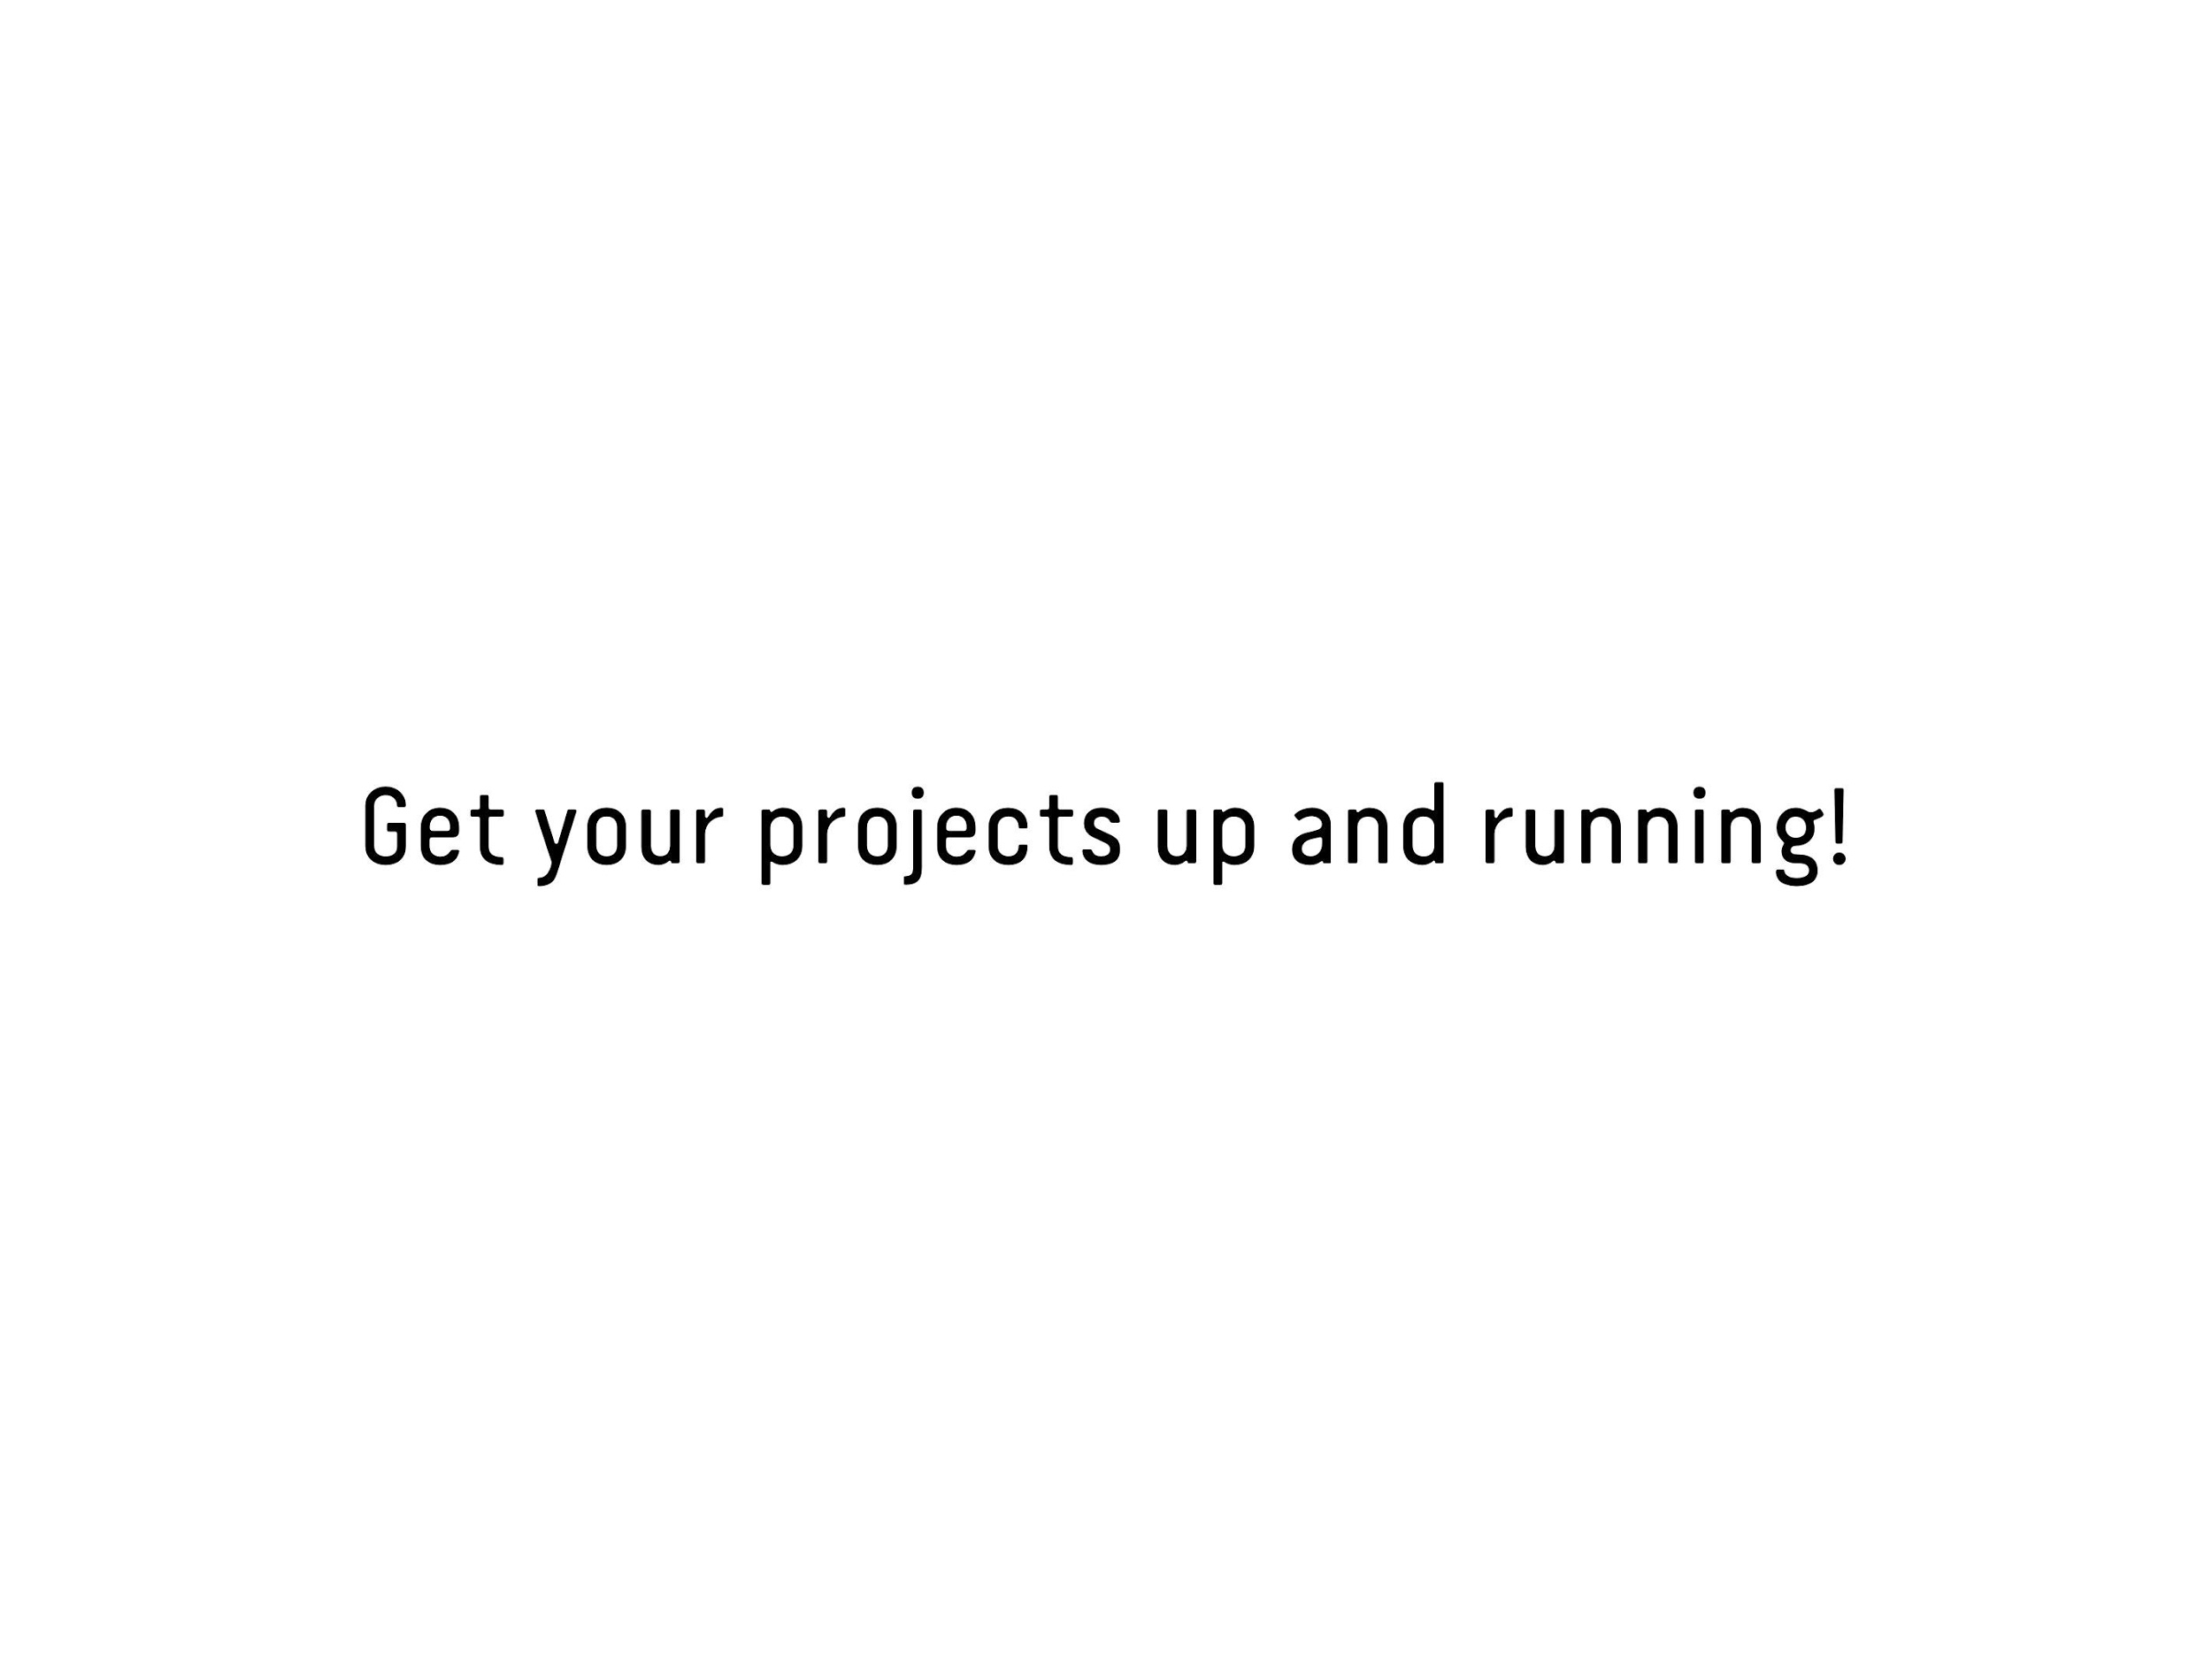

Slide 29
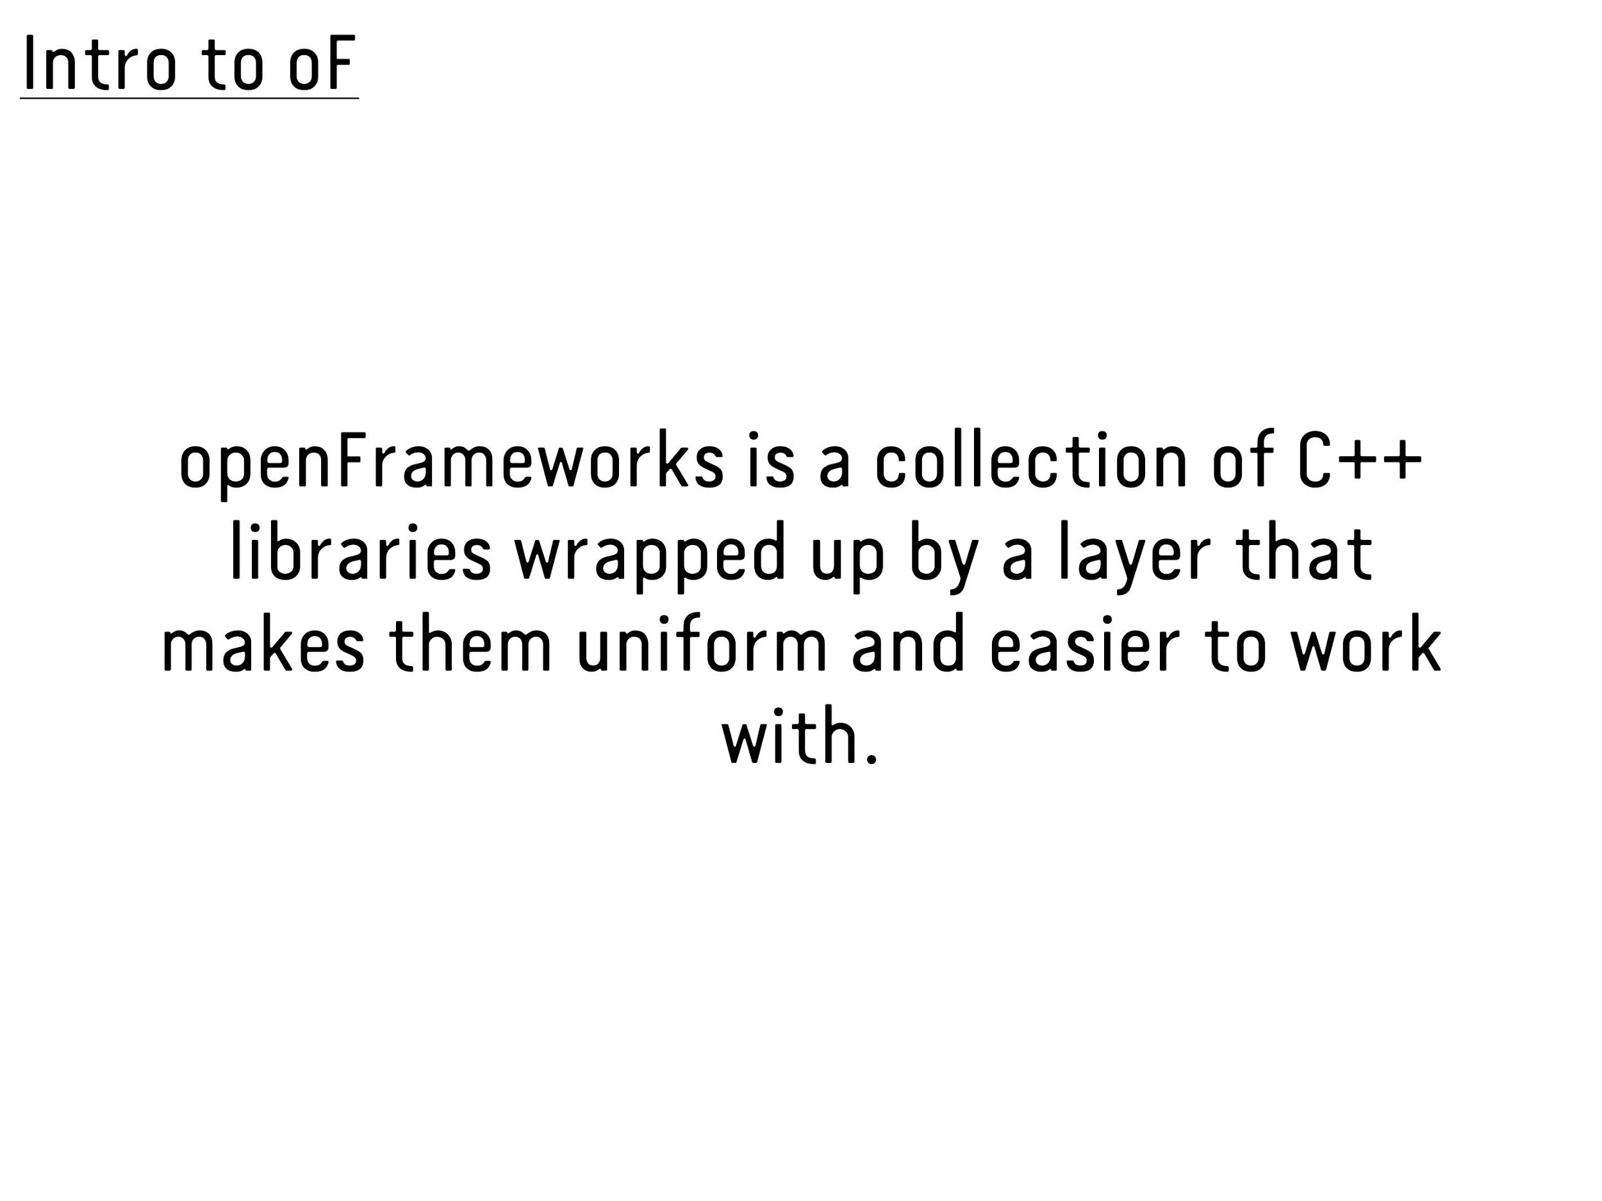

Slide 30


Slide 31
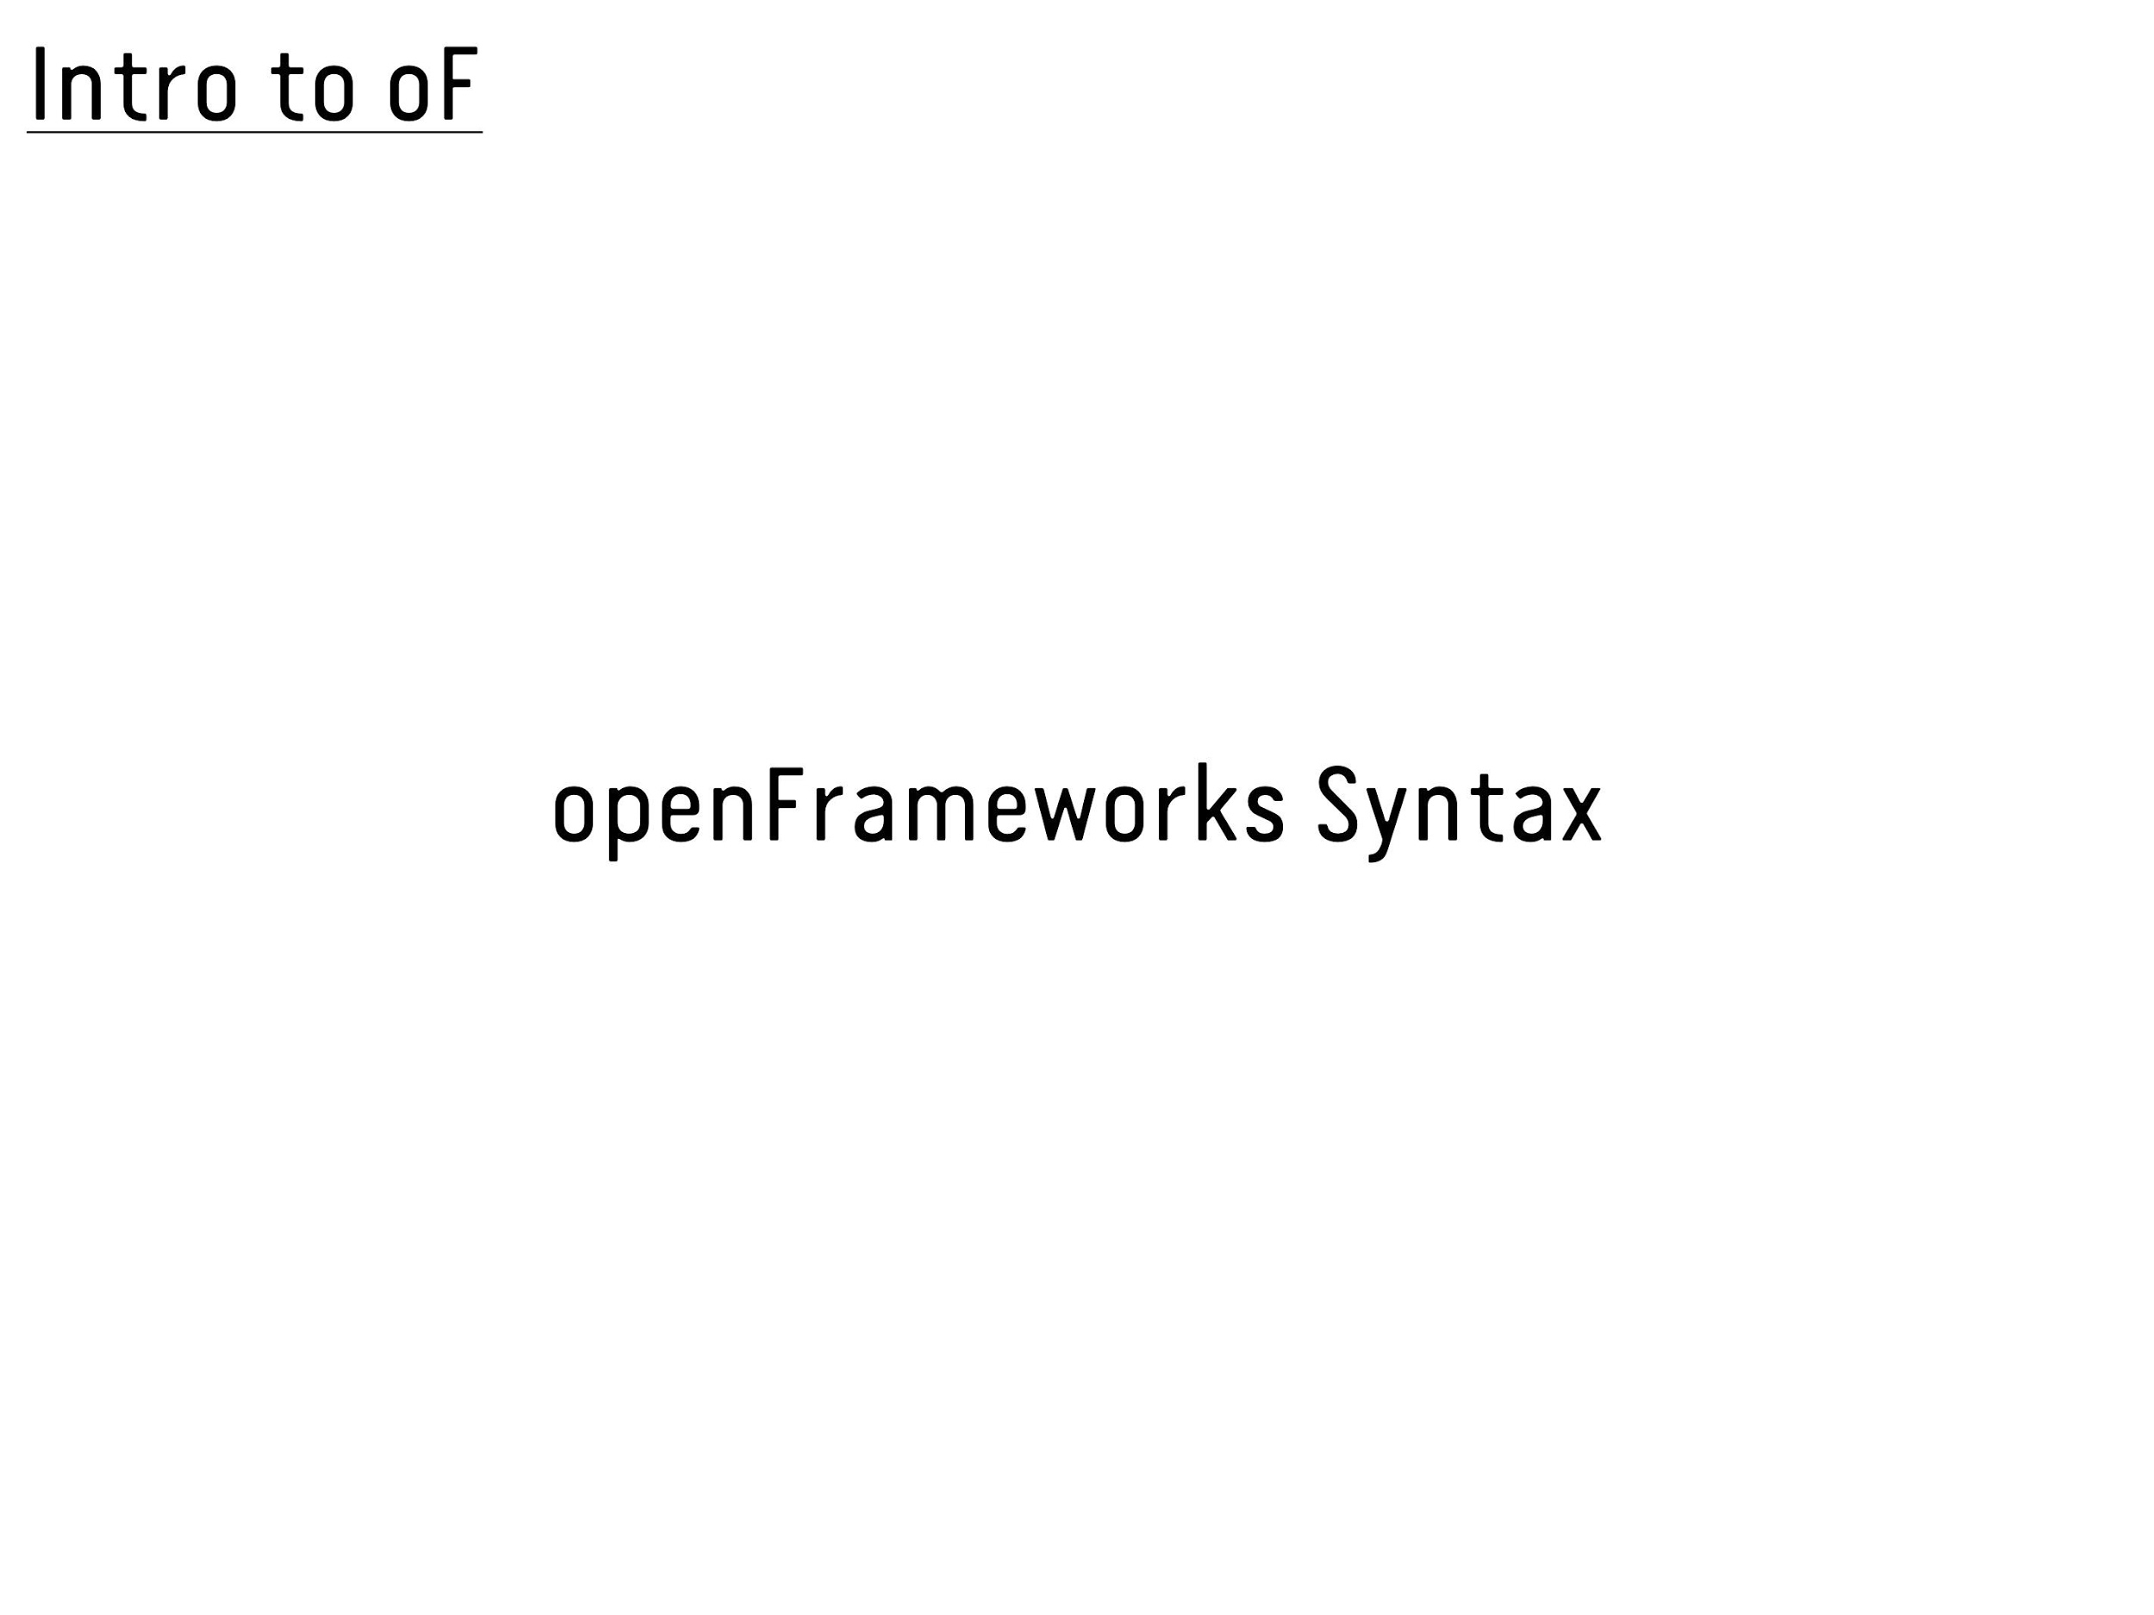

Slide 32
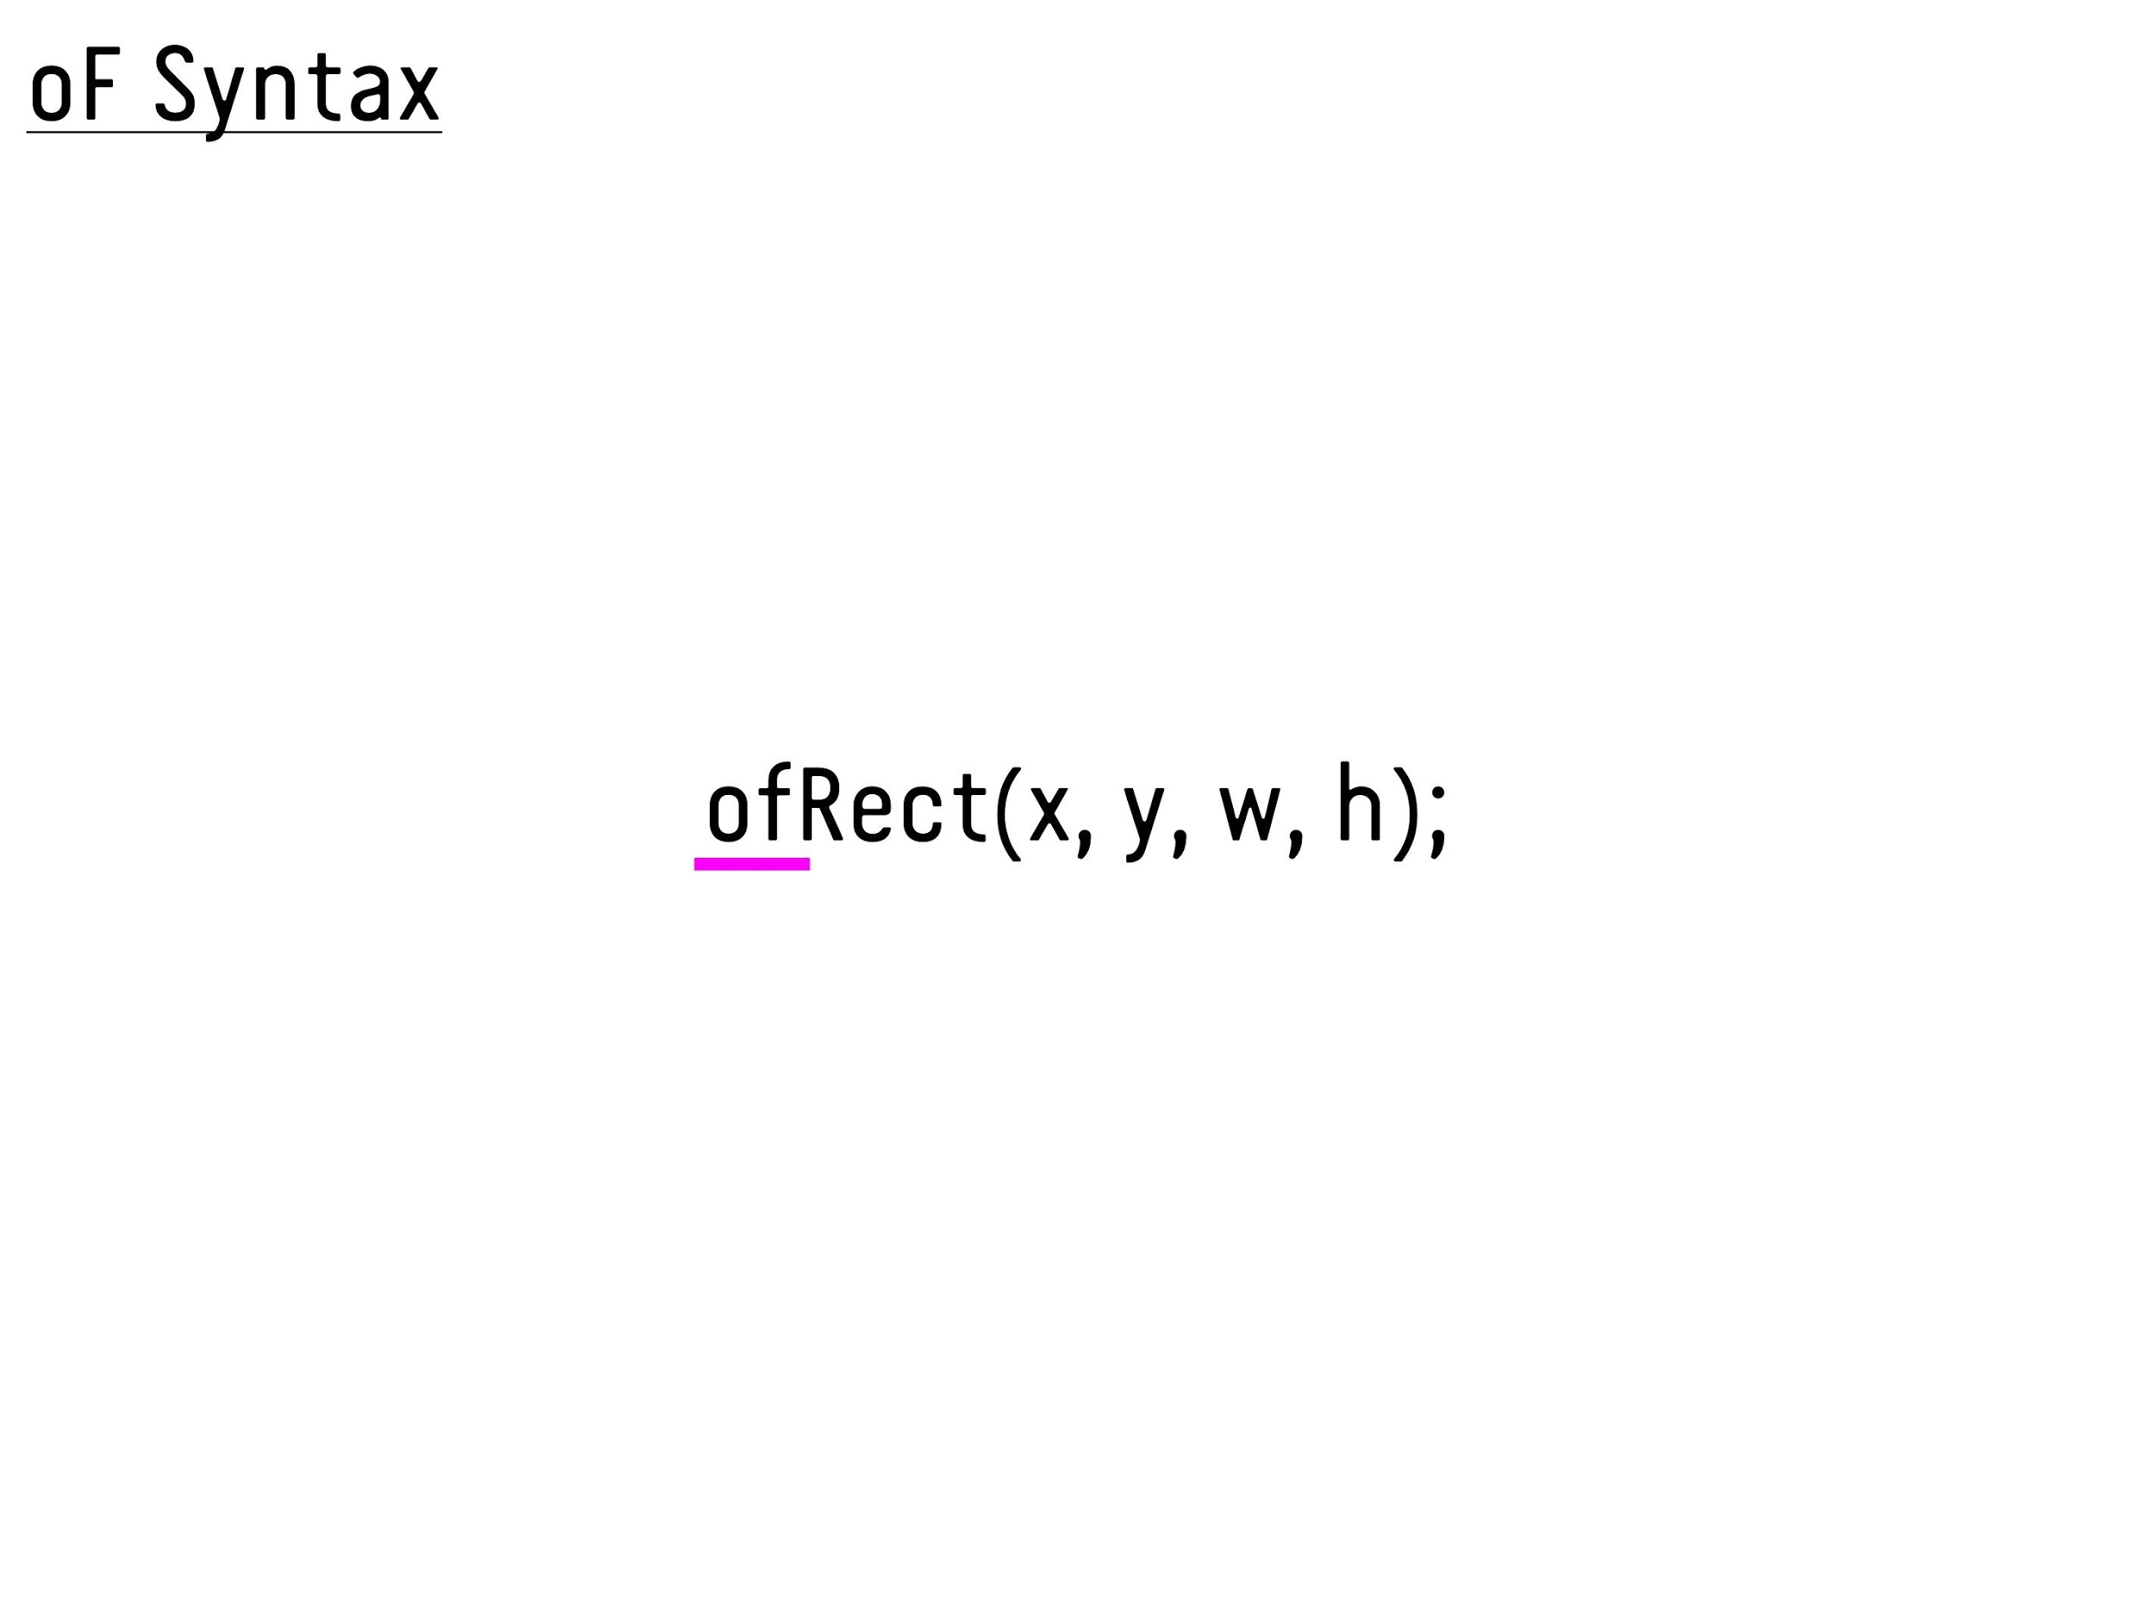

Slide 33
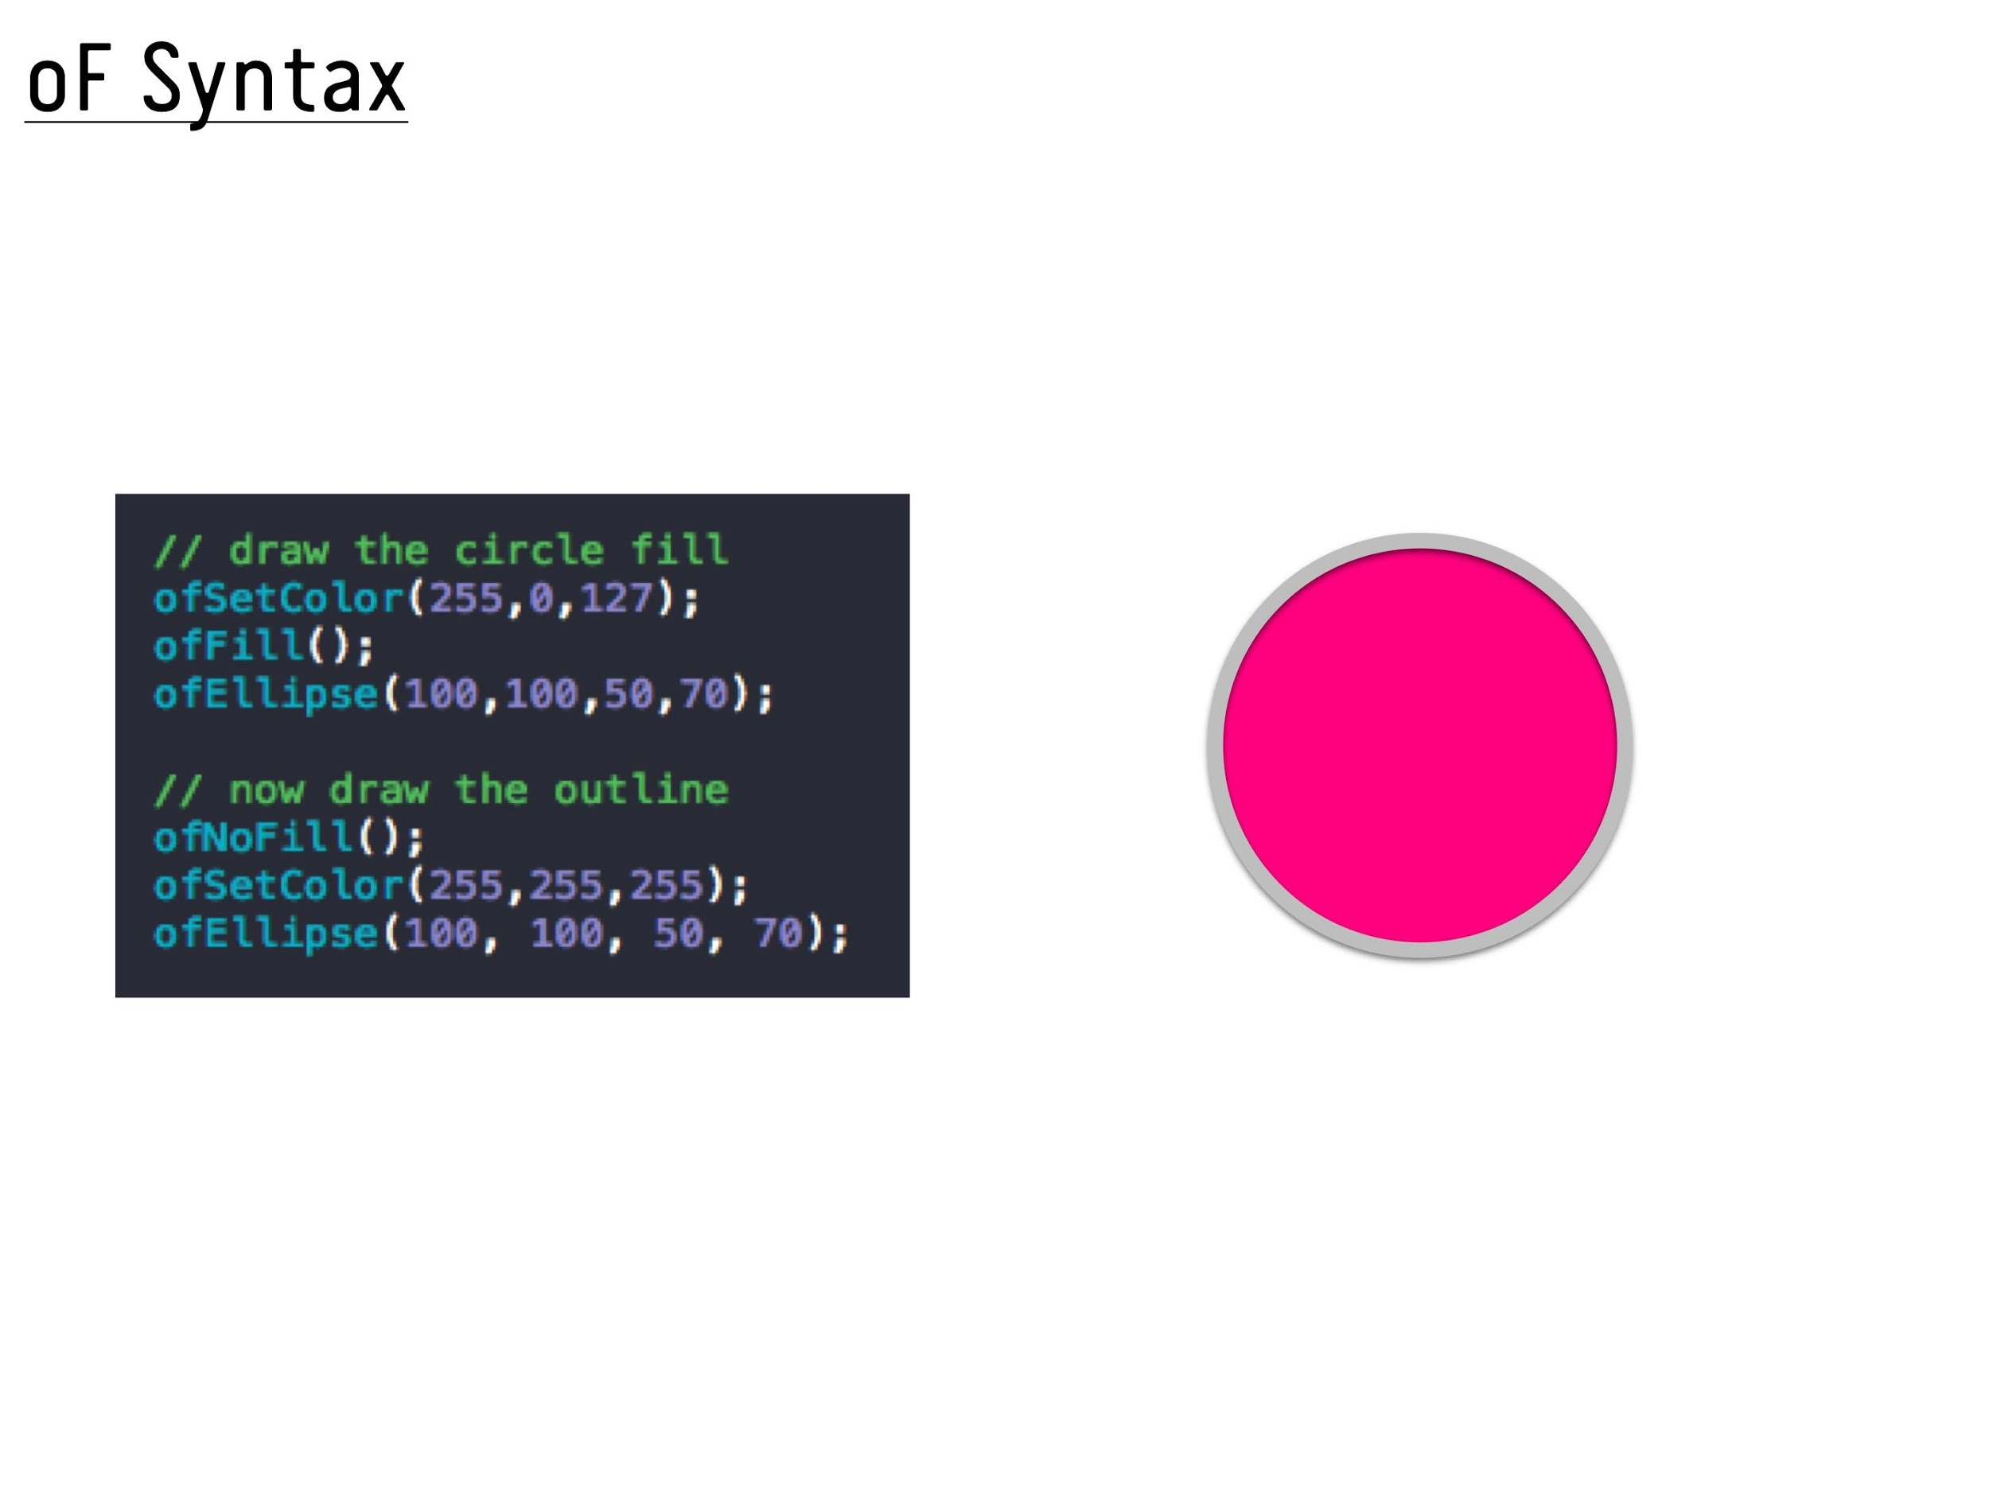

Slide 34
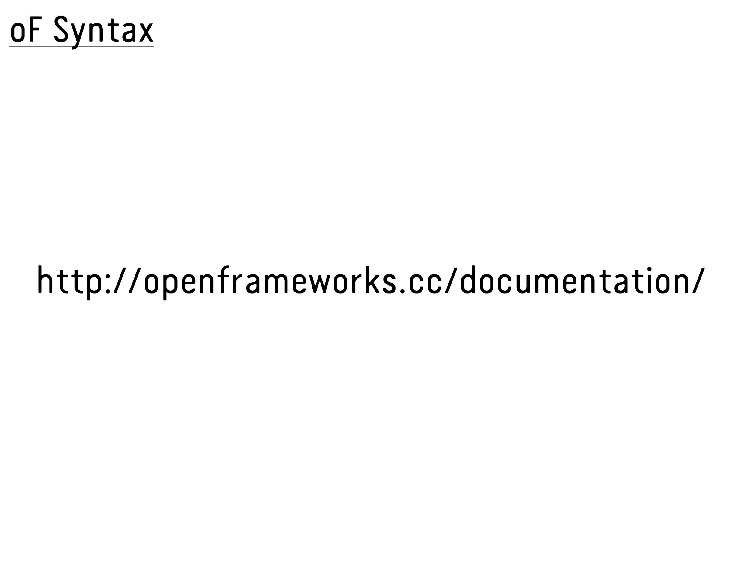

Slide 35
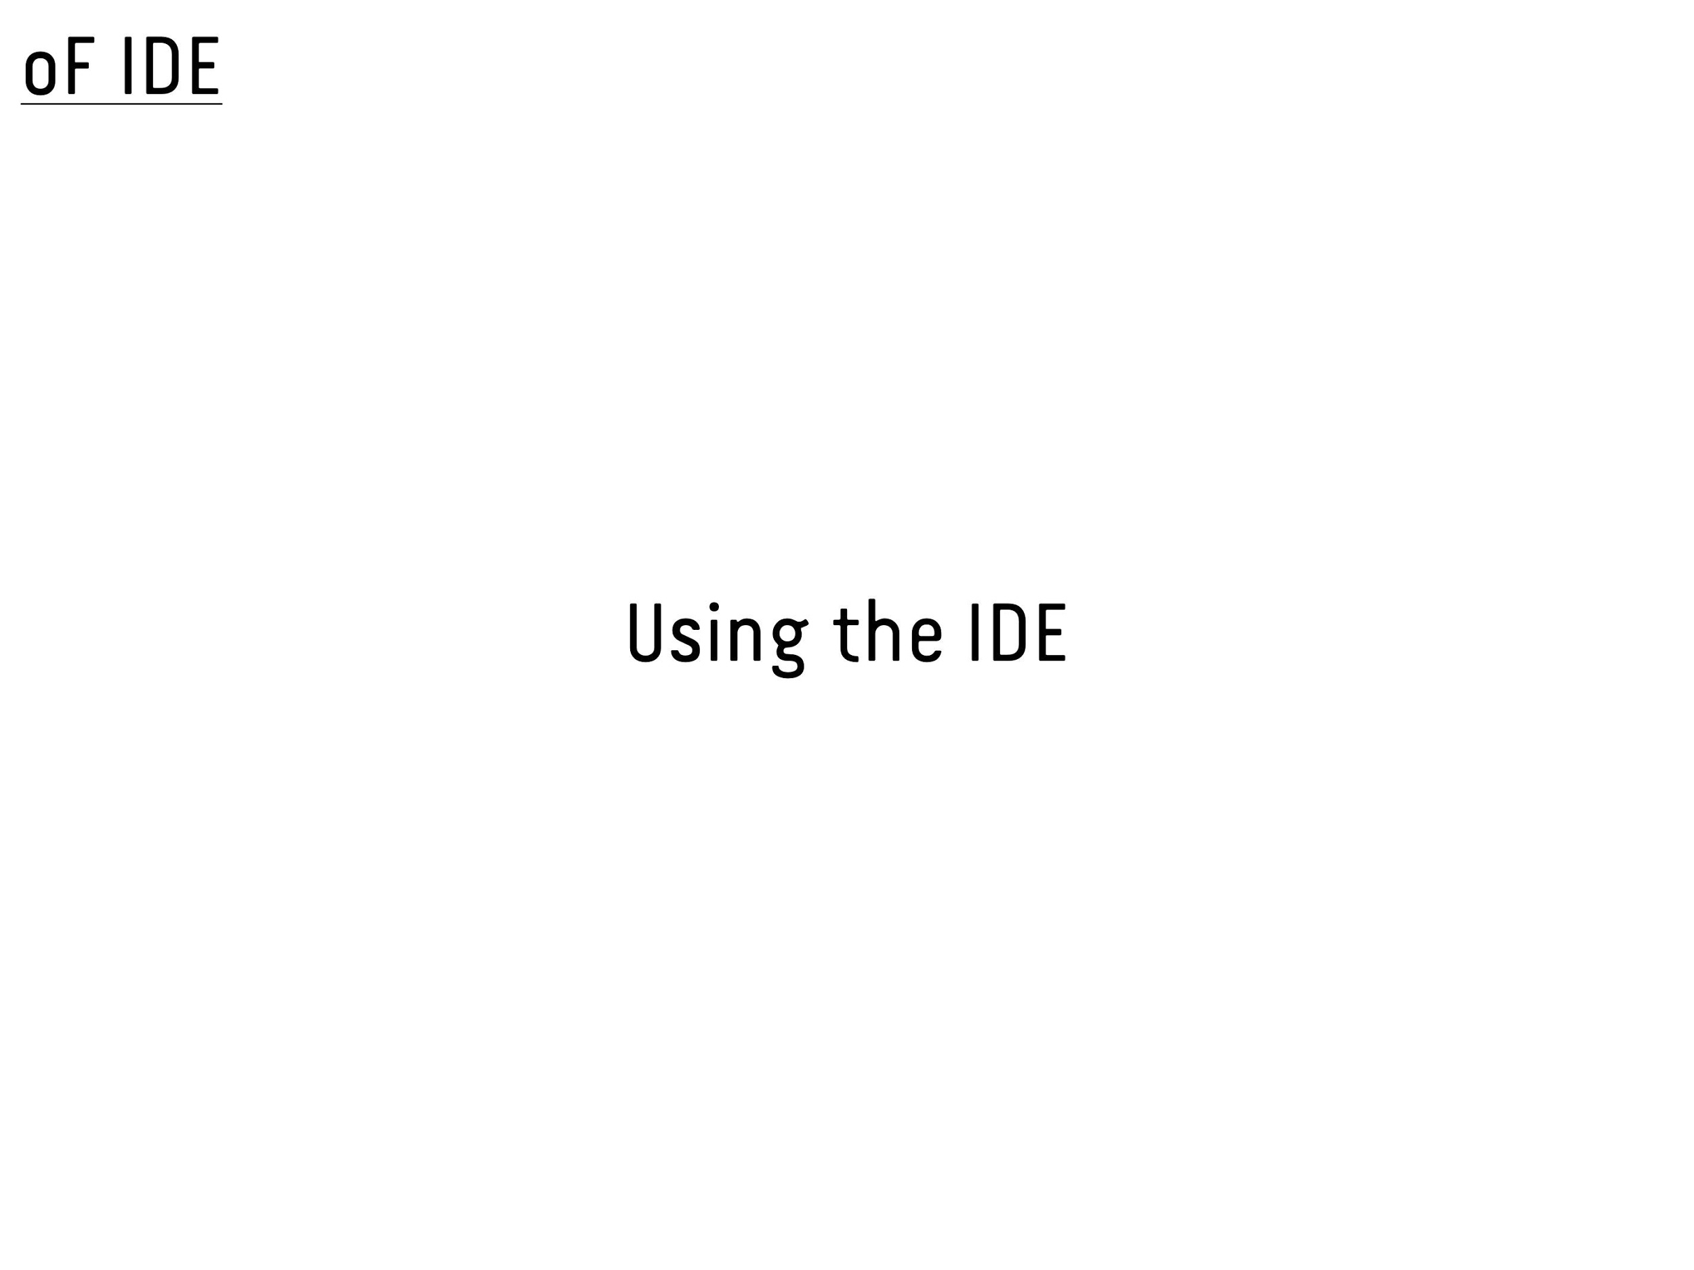

Slide 36
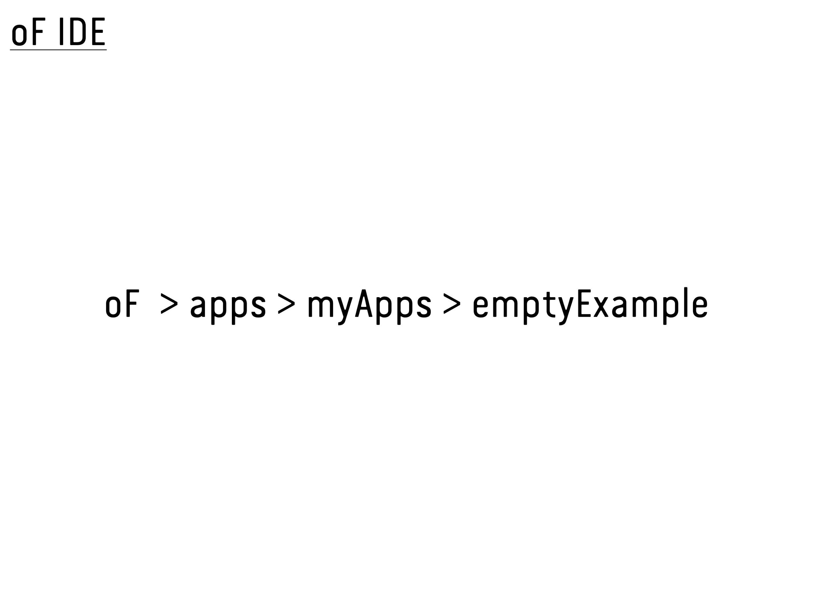

Slide 37
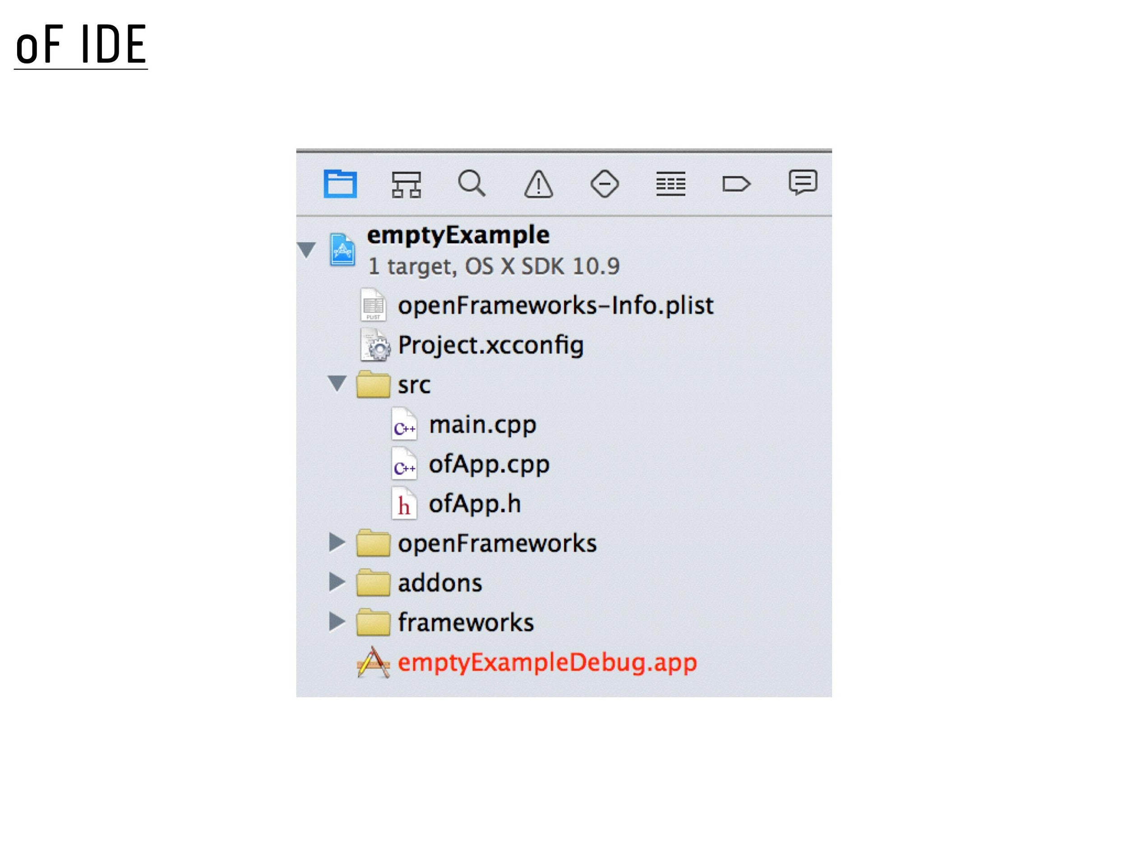

Slide 38
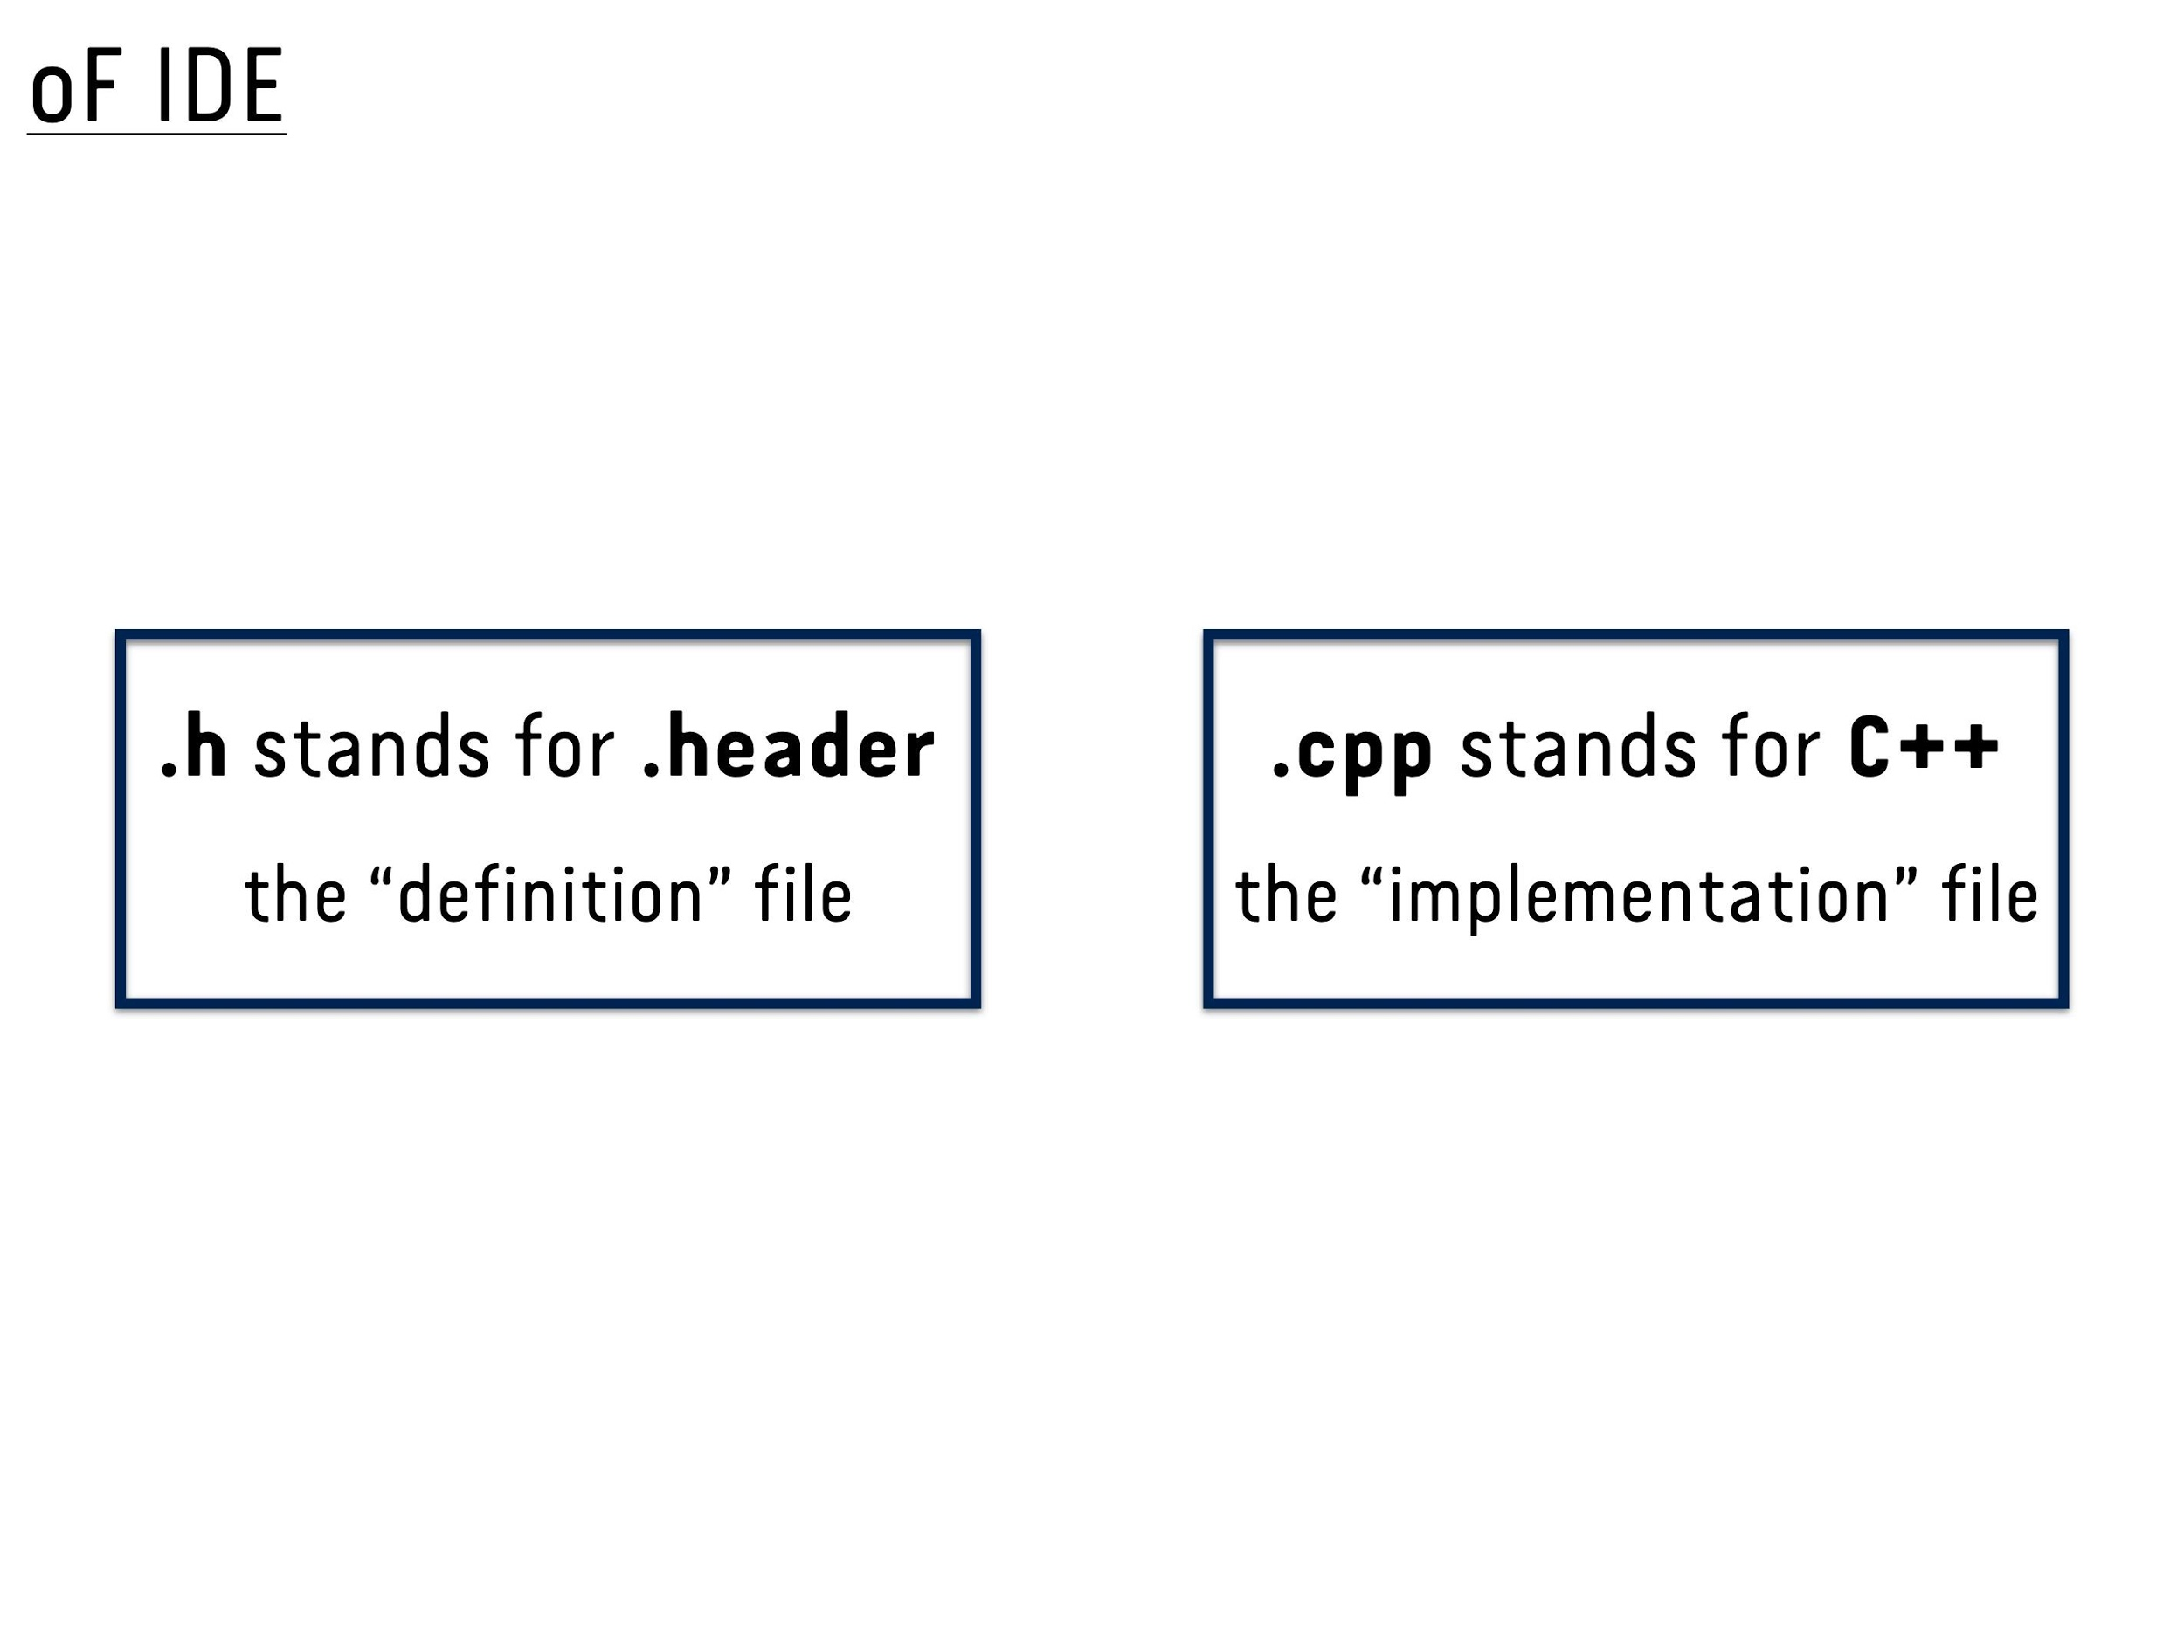

Slide 39
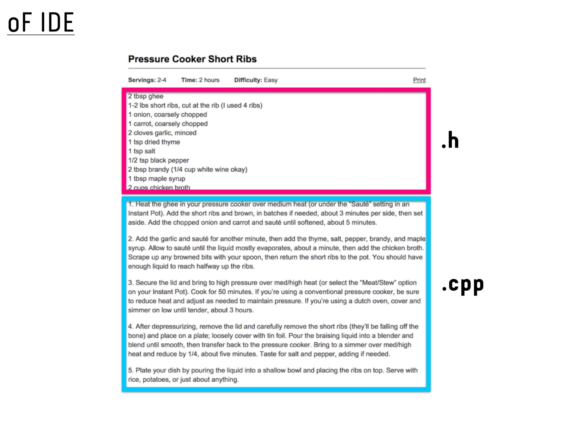
Notes:
- The main () methods sets up the window size and runs the program

Slide 40
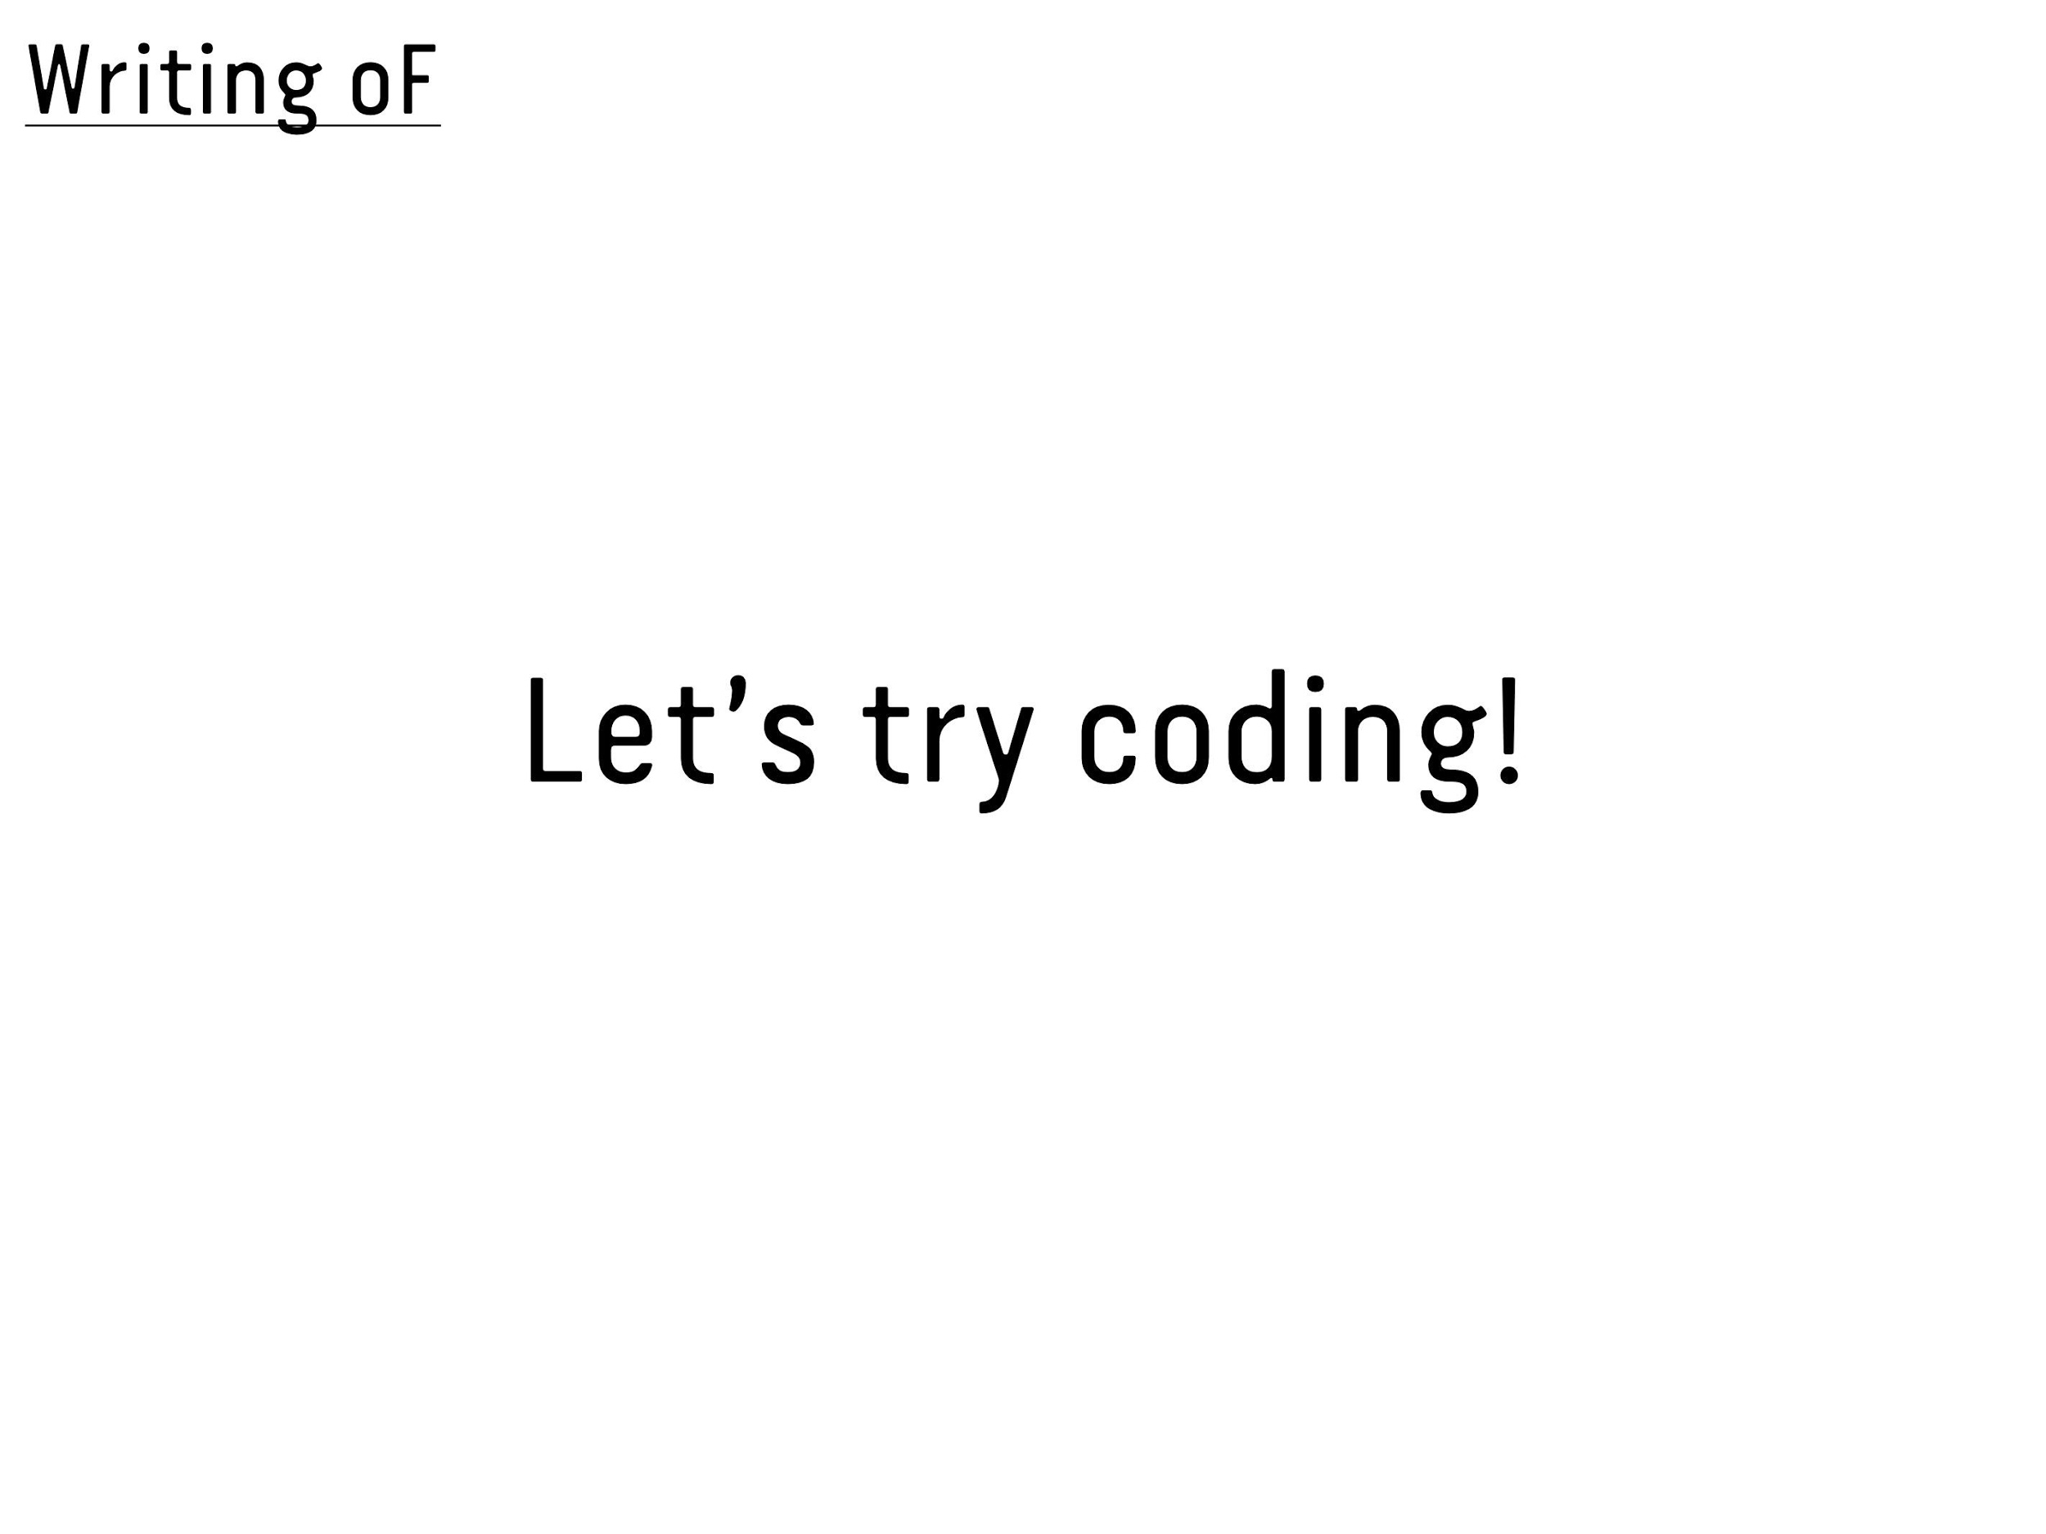

Slide 41
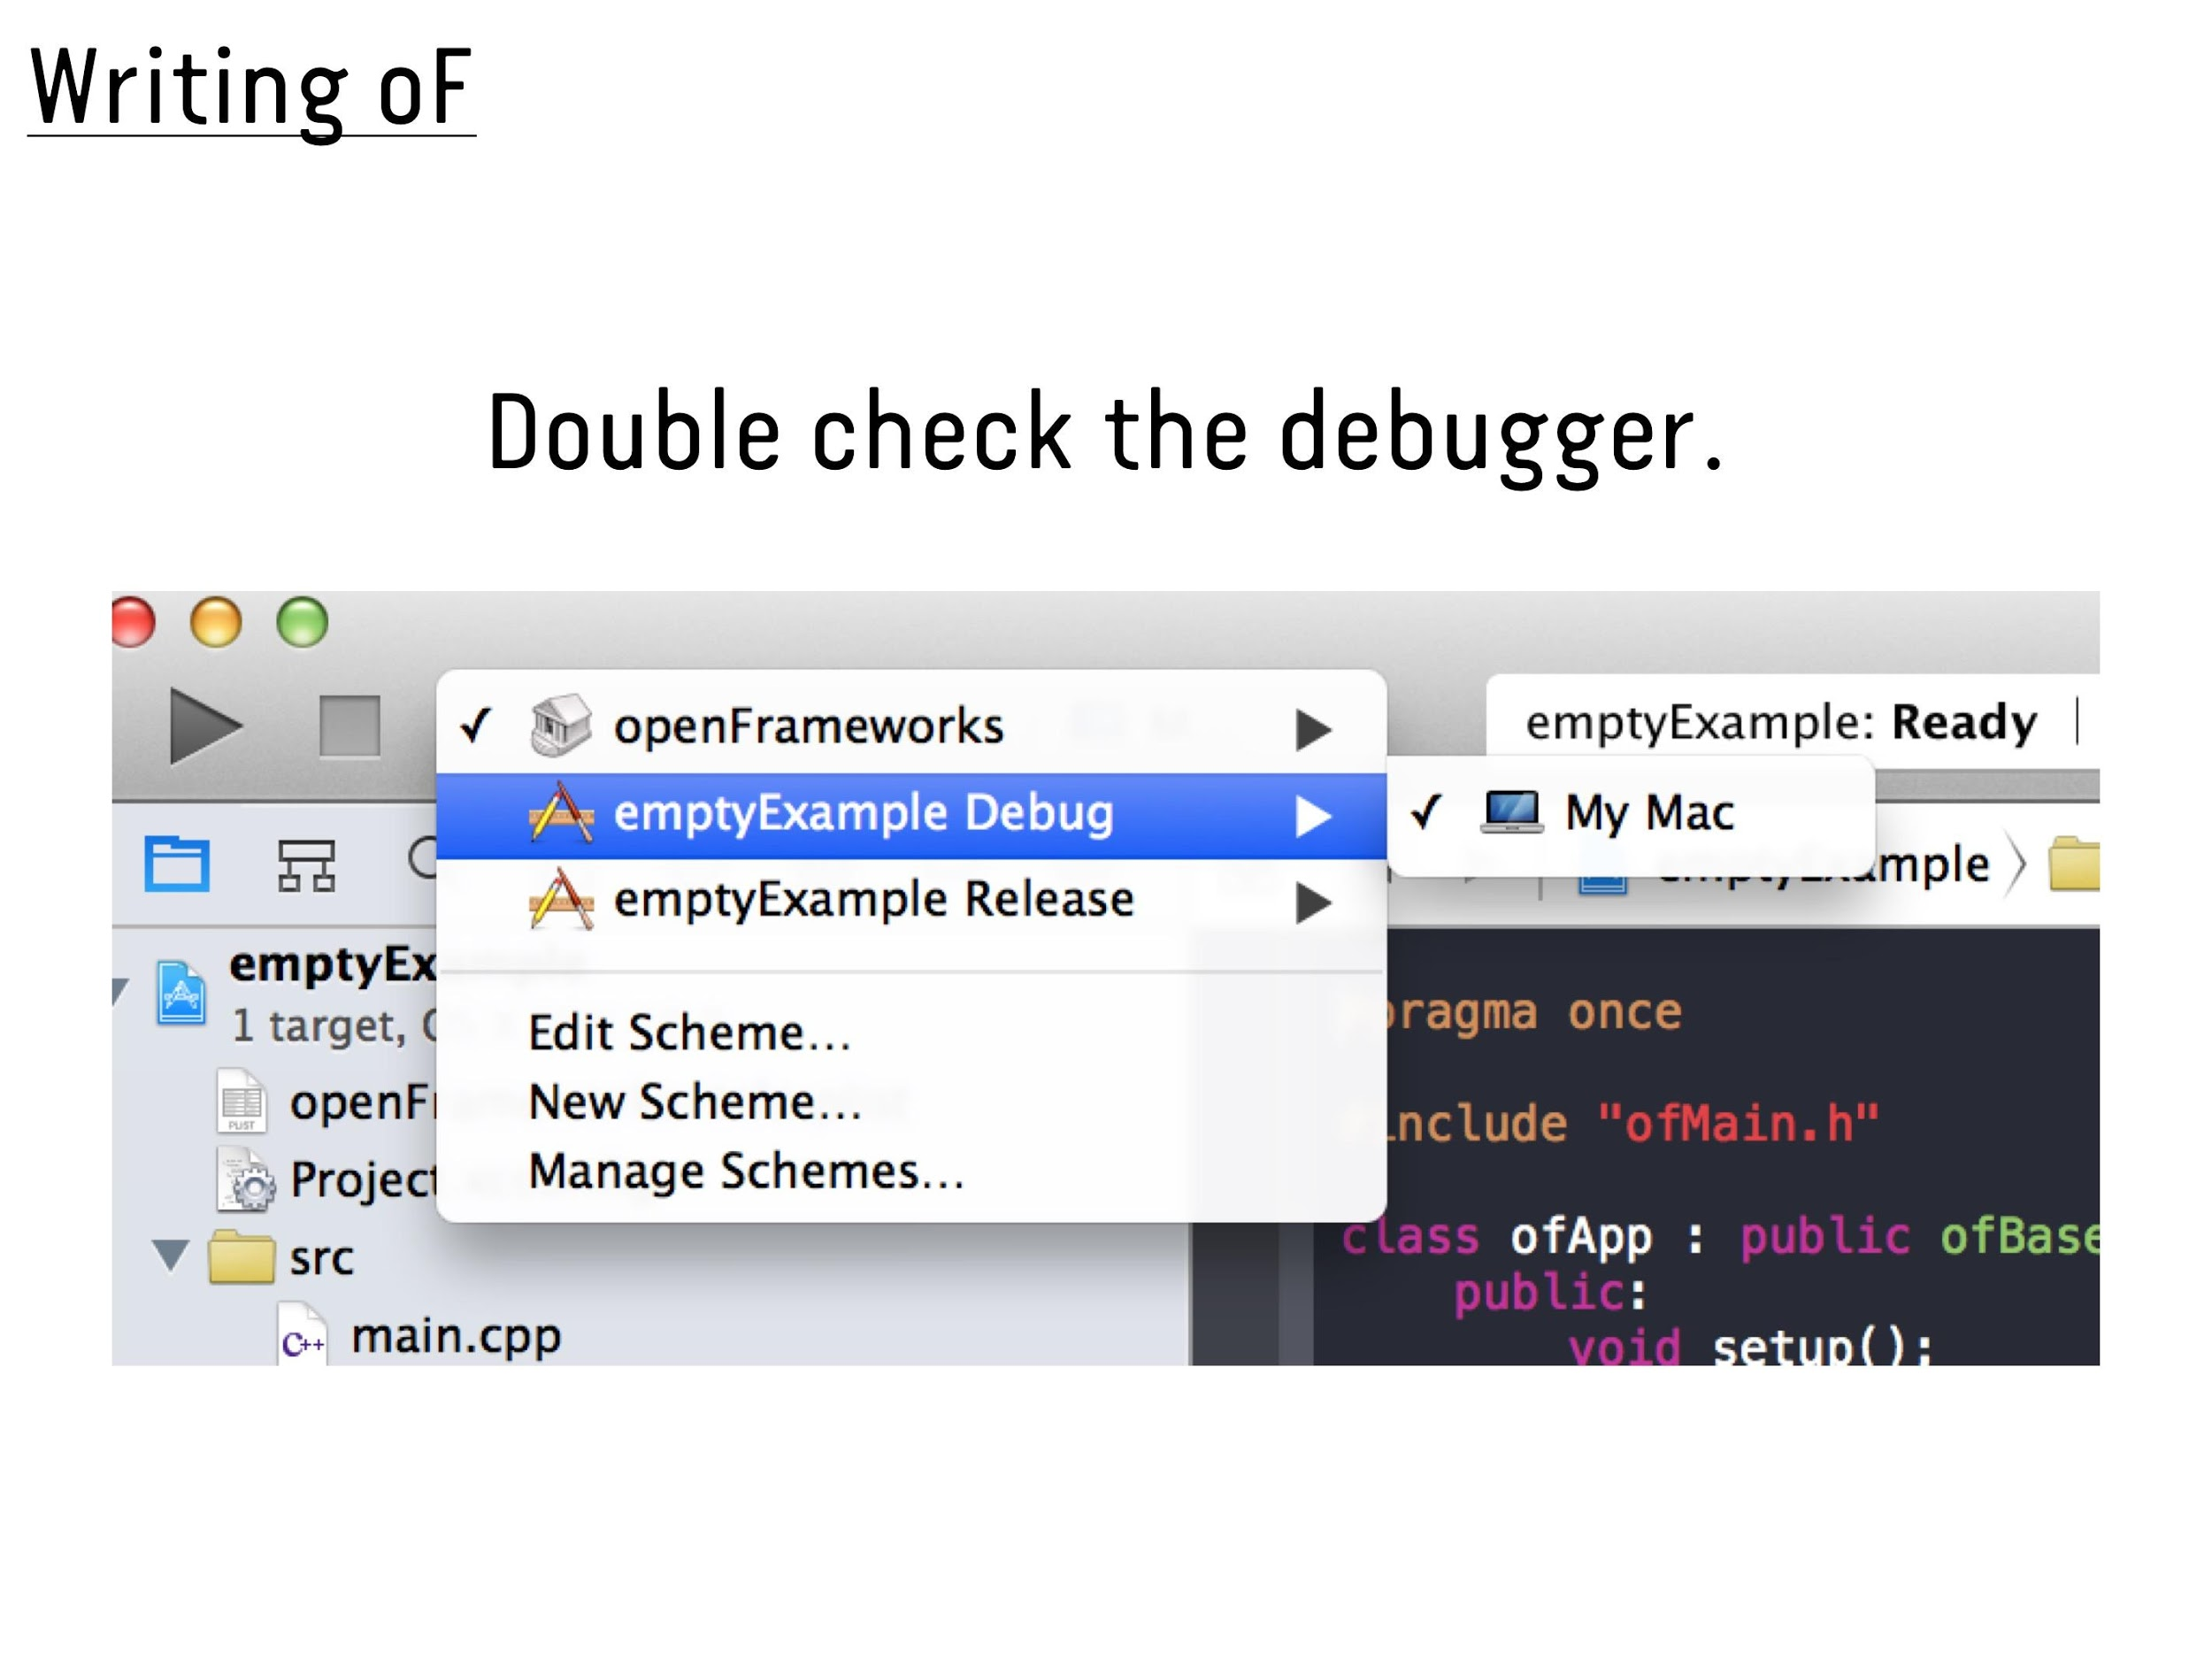

Slide 42
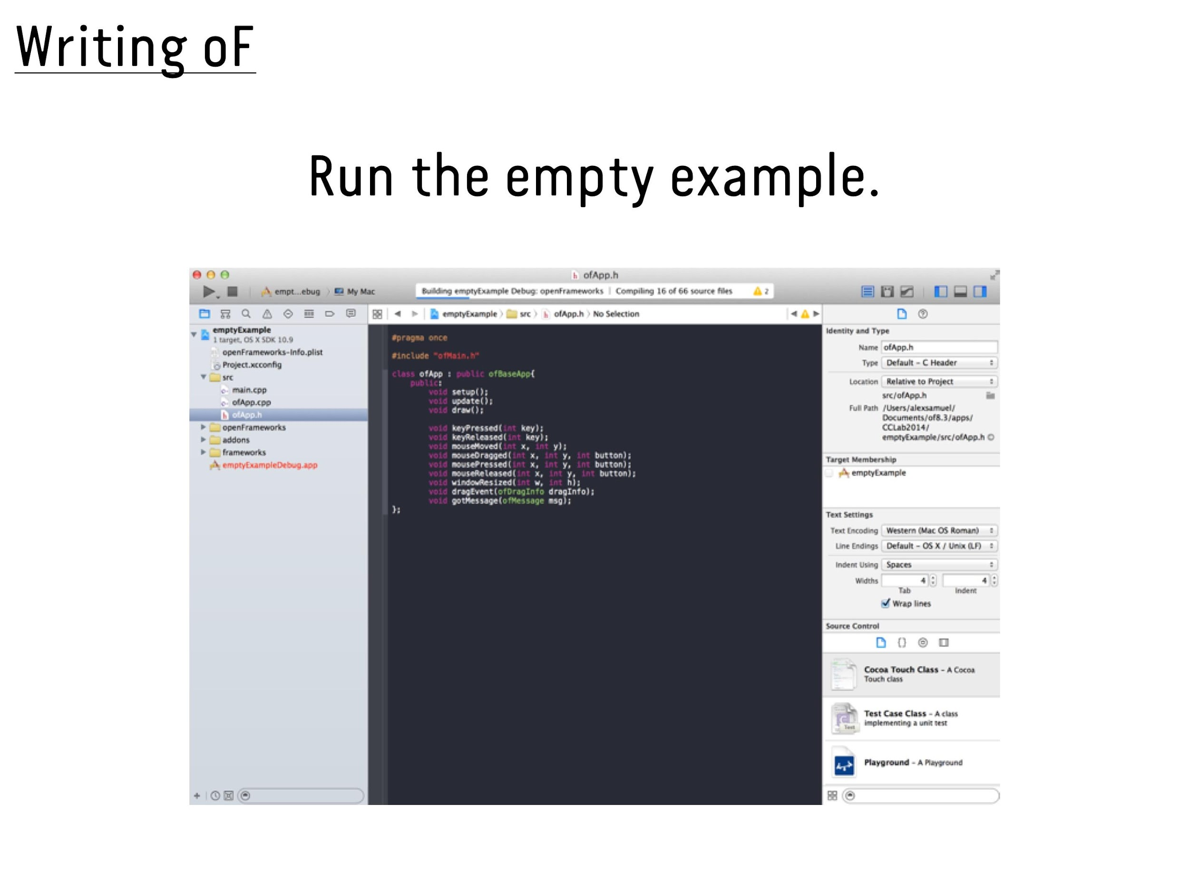

Slide 43
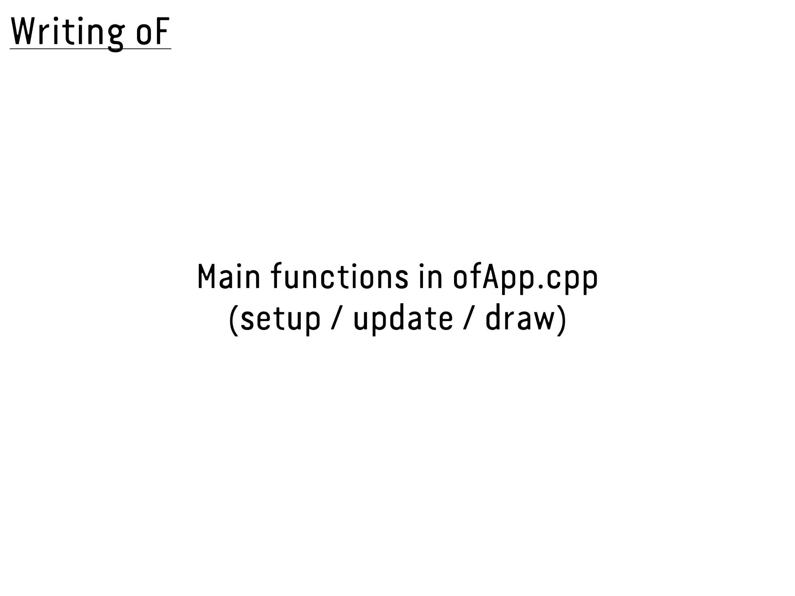

Slide 44
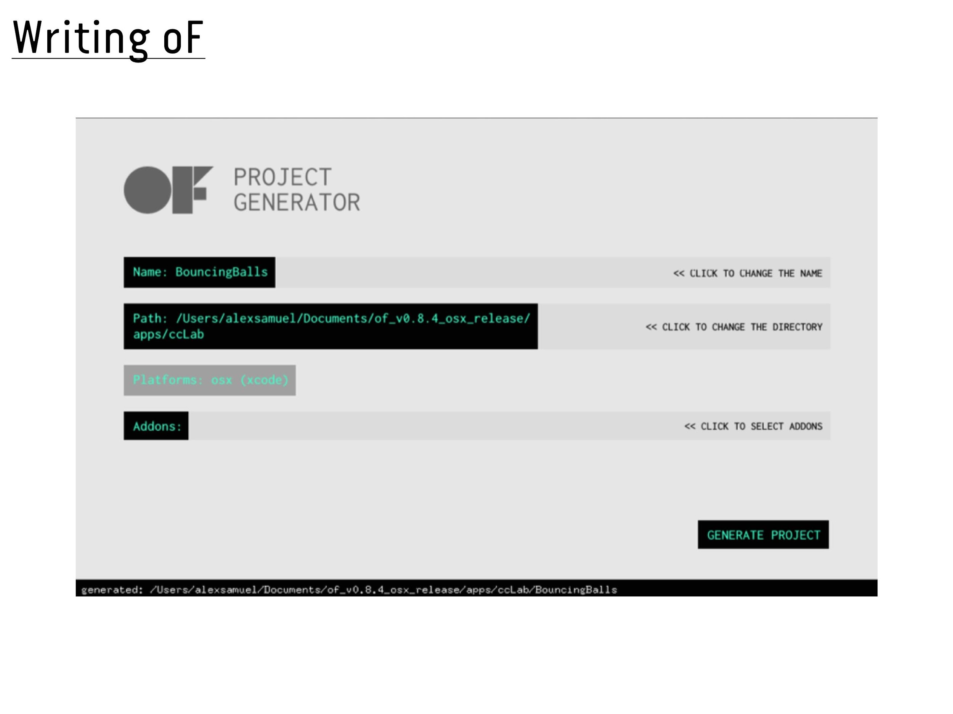

Slide 45
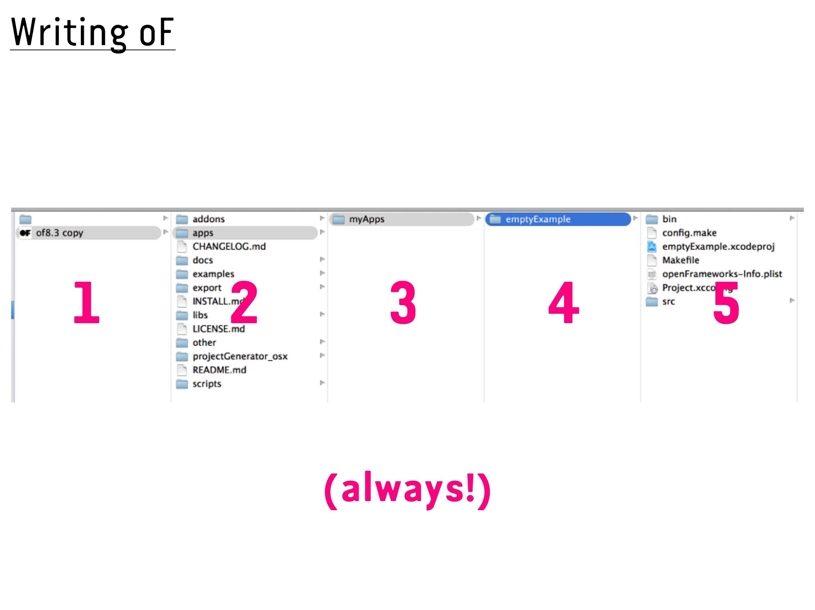

Slide 46
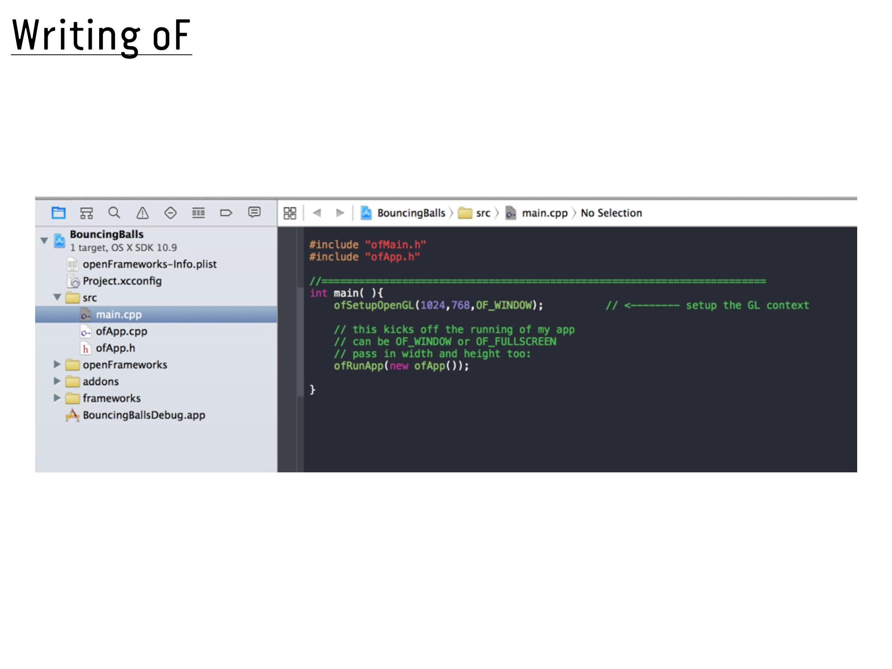

Slide 47
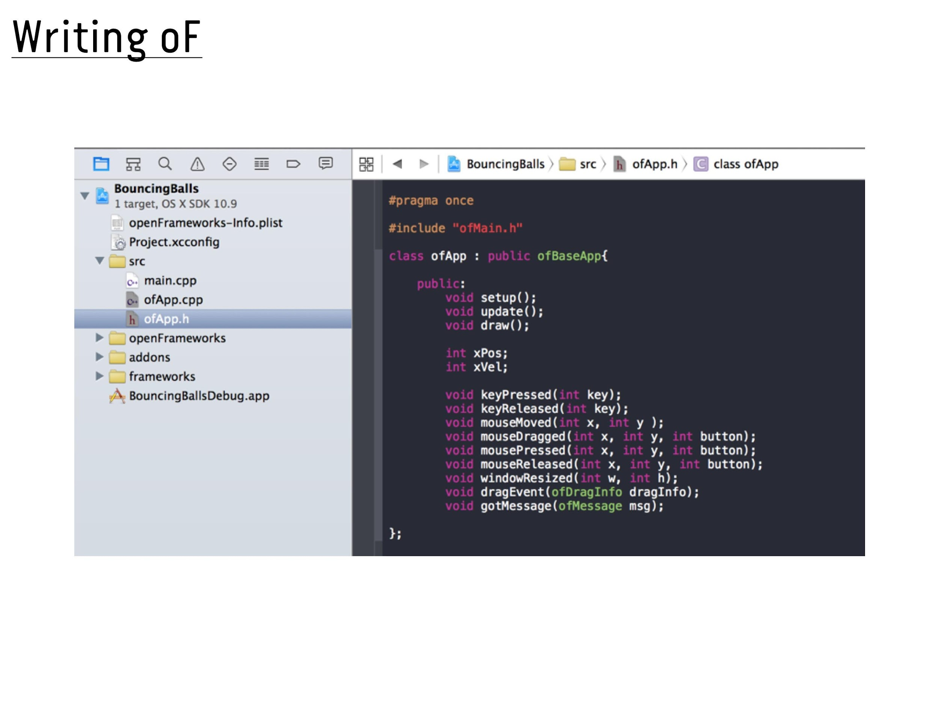

Slide 48
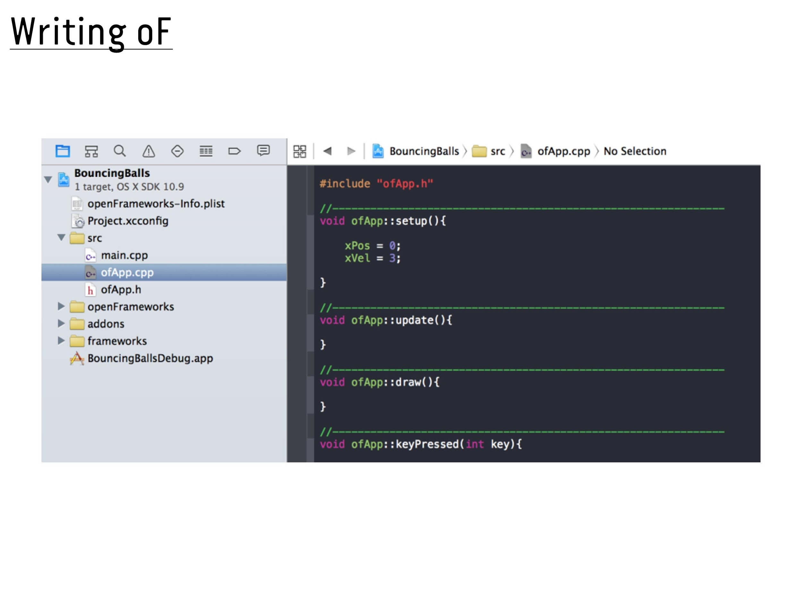

Slide 49
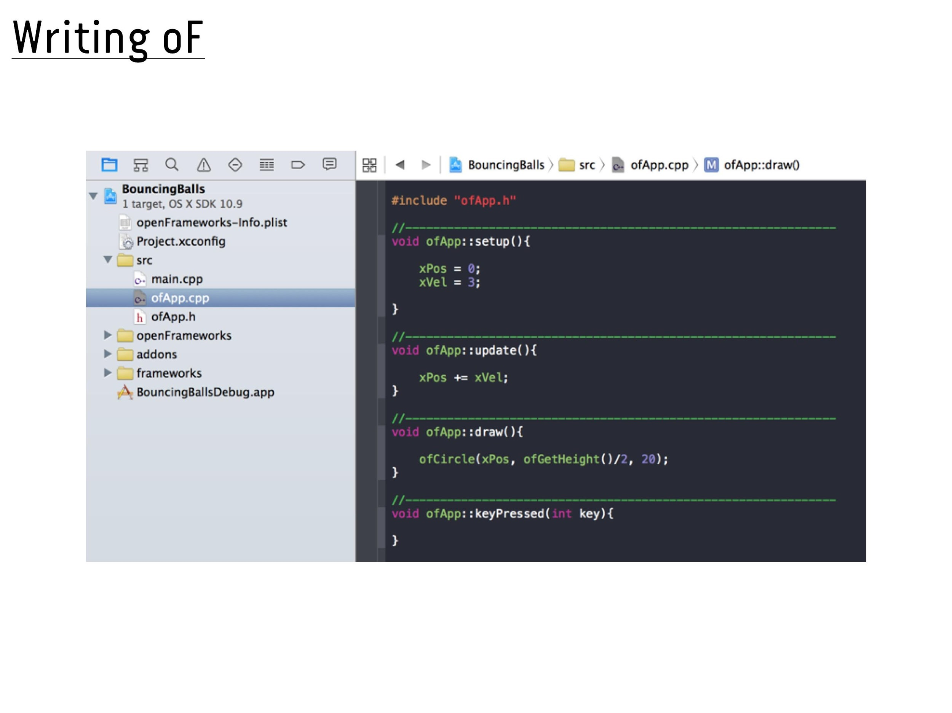

Slide 50
PRINCIPLES OF OBJECT
ORIENTED CODING

Slide 51
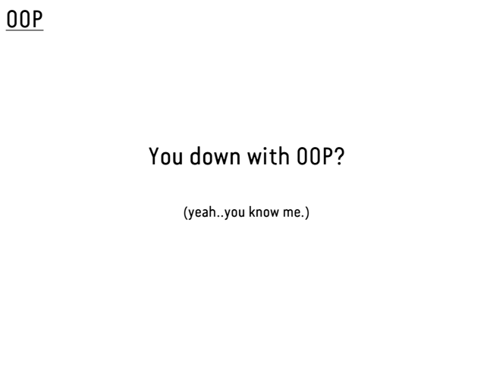

Slide 52
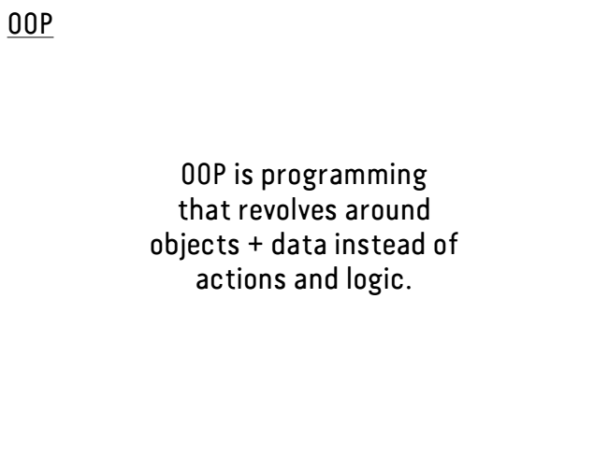

Slide 53
Classes & objects are used as fundamental units to organize your code.

Slide 54
Class is the blueprint for what kind of object the class will create.
Notes:
-talk about car example
-. It contains variables and methods into an object that contains and controls access to them all.

Slide 55
What classes would a game about spaceships have?
Notes:
Spaceship, enemy, aestroid

Slide 56
Class Structure
class Name { //class name
float posX; //declare variables
float posY;
Name() { //build constructor
posX = 50;
posY = 60;
}
void move() { //add movement method
posX += 5;
}
void display() { //add display method
ellipse(posX, posY, 5, 5);
} }
Notes:
Let’s build the Alphabet class called Alpha. Note Alpha is capitalized, this is the convention to differentiate it from variables and functions.
On screen you see the structure of the class.
First we NAME our class... we then place in and declare our VARIABLES. We create our CONSTRUCTOR where we initialize our variables. The constructor is like a default template. It is wise to include a constructor especially if you are not passing arguments to your object. Additionally it prevents your Processing from giving errors & it’s good practice. Finally we add any METHODS we want… note here we have a move and display method. Don’t forget to close our class with a }
If you do wish to pass arguments to your object see Objects EX3. We will go over the example file for clarity.

Slide 57
PSEUDO CODE Dog

Slide 58
Rule: classes should be nouns & methods should be verbs

Slide 59
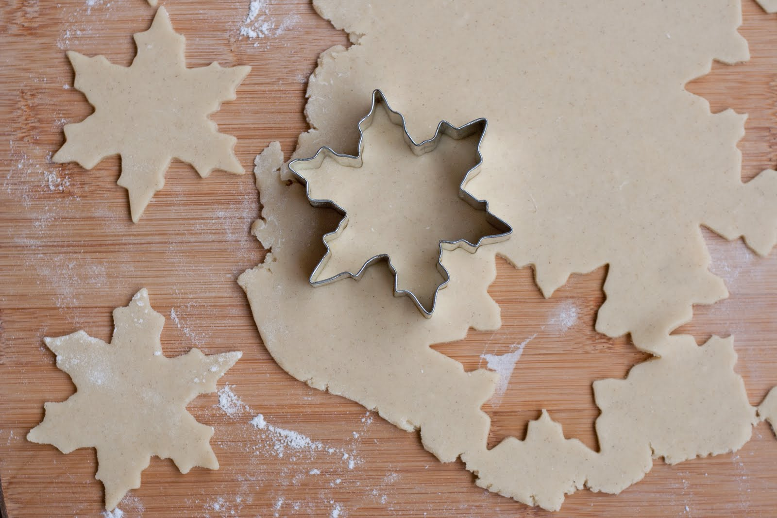
Cookie Cutter
object
class
object
Notes:
One of the great things about using objects is the ability to create multiple objects from the same class… note that though the objects are of the same class, they can vary in their qualities. In our class our class is Alpha which represents our Alphabets, while an instance of the class (letter) would be our object.

Slide 60
Public VS Private
Notes:
Methods or properies that aren’t necessary for the outside world to use or manipulate can be declared private to keep objects outside the classes accessing them or using them inappropriately

Slide 61
Class structures are used to avoid duplicating code and making your code easier to read.

Slide 62
Inheritance means that a class you’re making extends another class, getting all methods and variables that are public.
Notes:
-draw diagram

Slide 64
CREATING CLASSES
OPENFRAMEWORKS

Slide 65
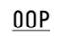
var Alec = {
var teach = function(lesson){
console.log(‘Today we’ll learn ‘ + lesson + ‘!’) };
var cats =[‘Arial’, ‘Luna’];
var home = Bushwick;
};

Slide 66
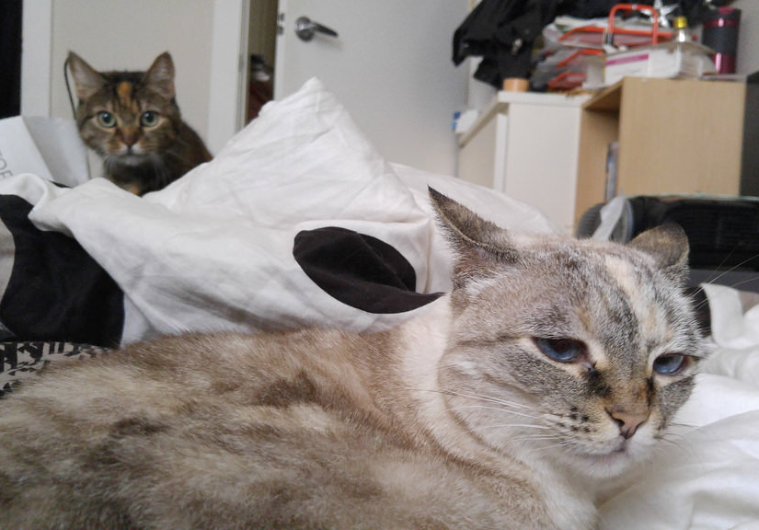
Alec.teach(‘OOP’); ‘Today we’ll learn OOP!’
Alec.cats.length; 2
Alec.home; Bushwick

Slide 67
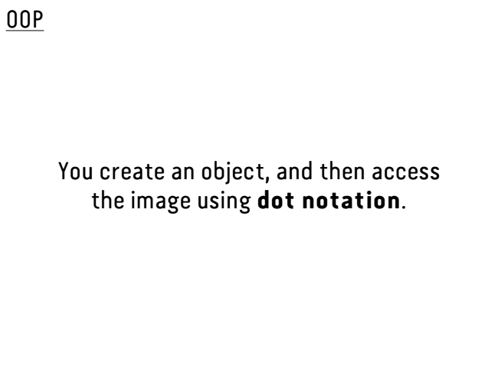

Slide 68
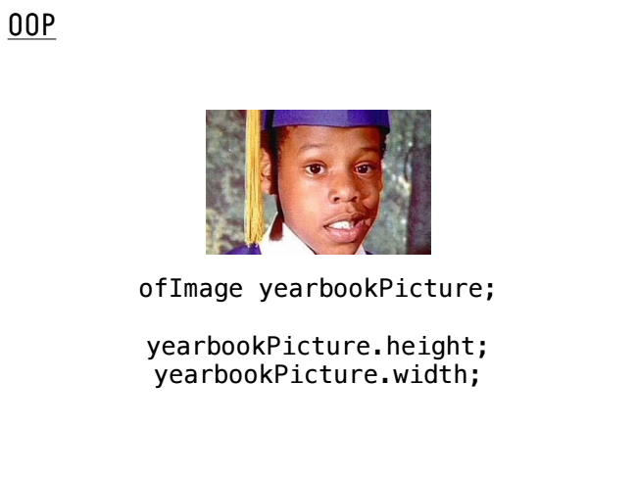

Slide 69
Like “ofApp”, oF (C++) classes
usually include a .h and .cpp file.

Slide 70
Start a new oF project using the
Project Generator

Slide 71
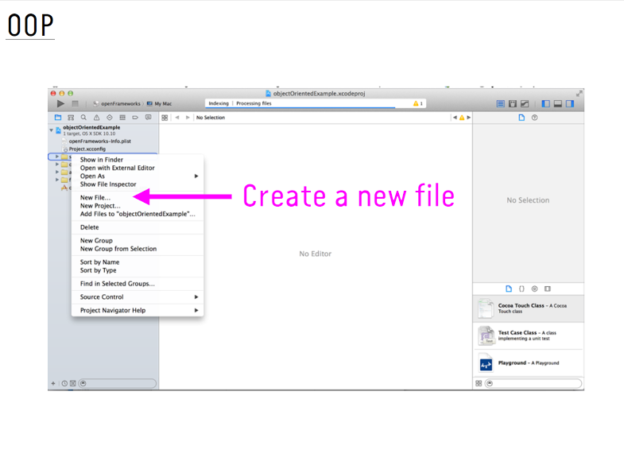

Slide 72
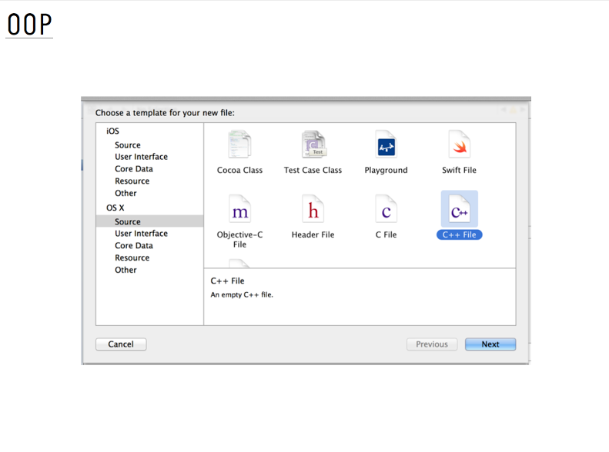

Slide 73
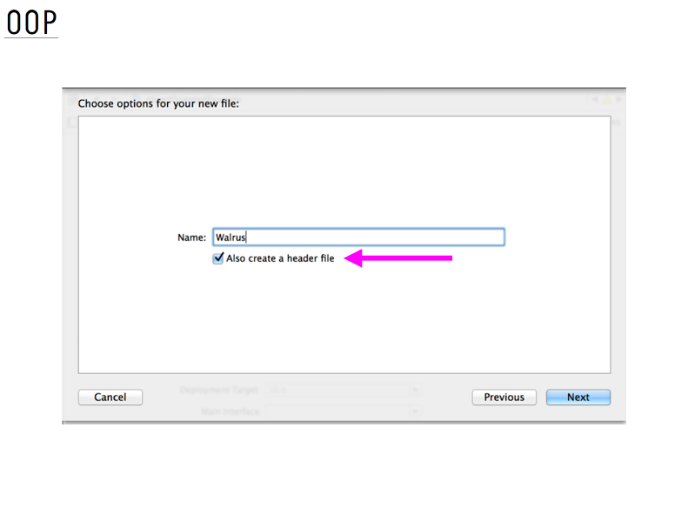

Slide 74
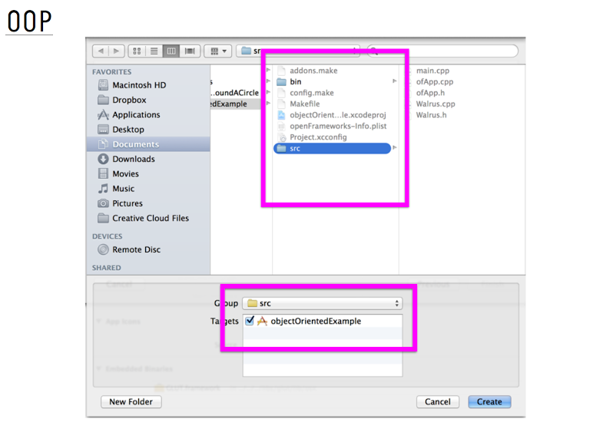

Slide 75
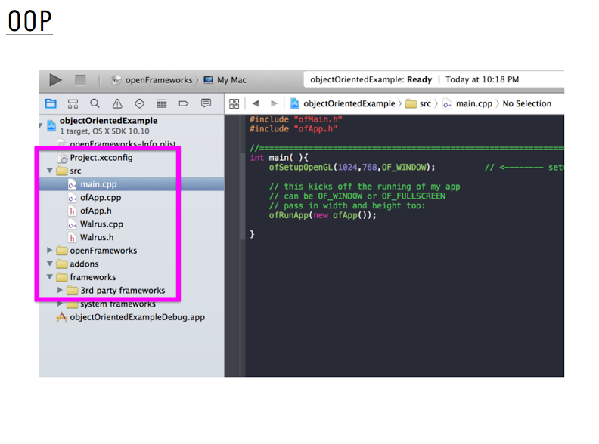

Slide 76
